Slide 1
Global Business Travel Association
Overview

Slide 2
Global Business Travel Association
Overview
GBTA is the world’s premier business travel and meetings organization
Collectively, GBTA’s 5,000-plus members manage over $340 billion of global business travel and meetings expenditures annually
GBTA provides its network of 21,000 business and government travel and meetings managers, as well as travel service providers, with networking events, news, education & professional development, research and advocacy

Slide 3
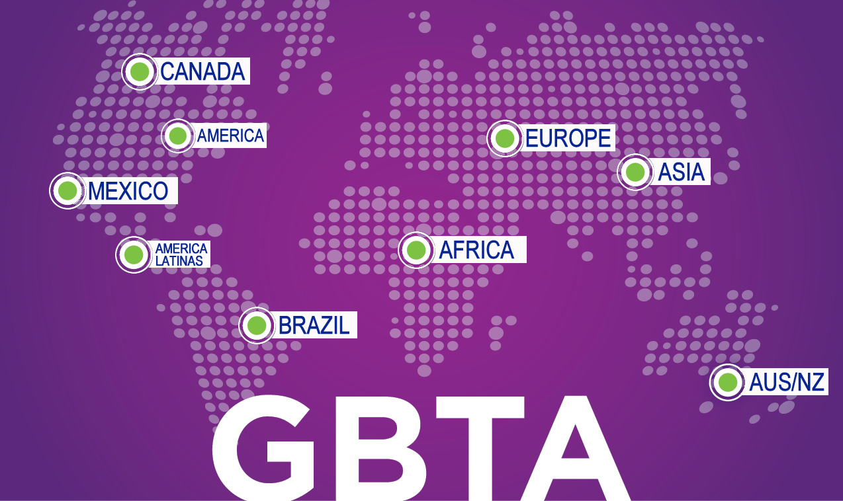
Notes:
GBTA has begun an active search for a new managing director for GBTA Asia.

Slide 4

Rapid Expansion Continues
2012
- Asia
- Africa
2013
- India
- Russia
- Middle East
2010-2011
- Europe
- Latin America

Slide 5
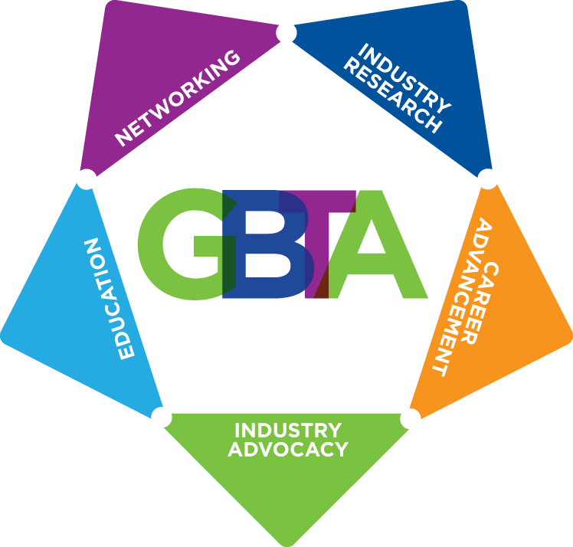
GBTA Membership

Slide 6
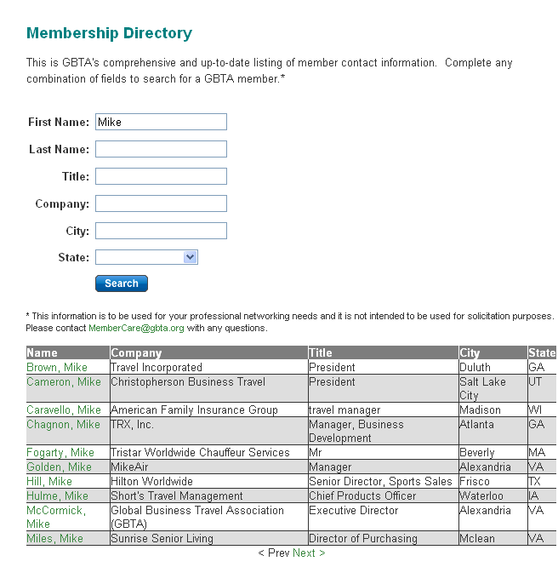
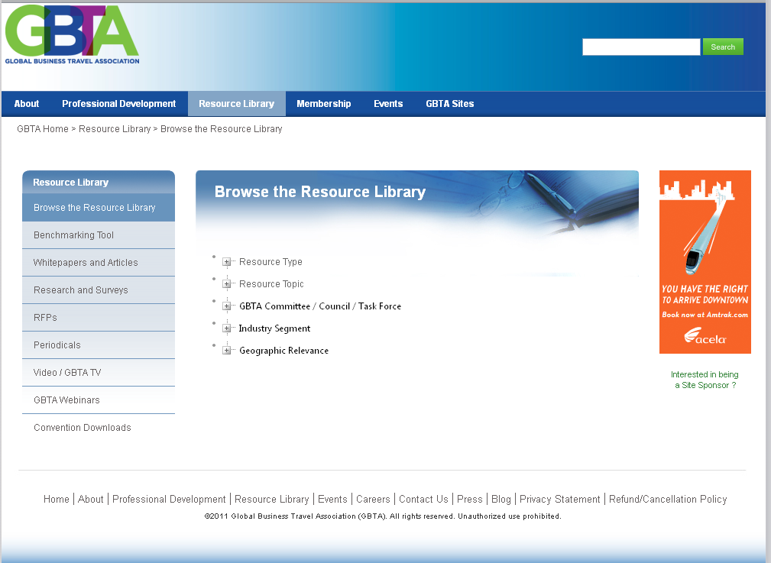
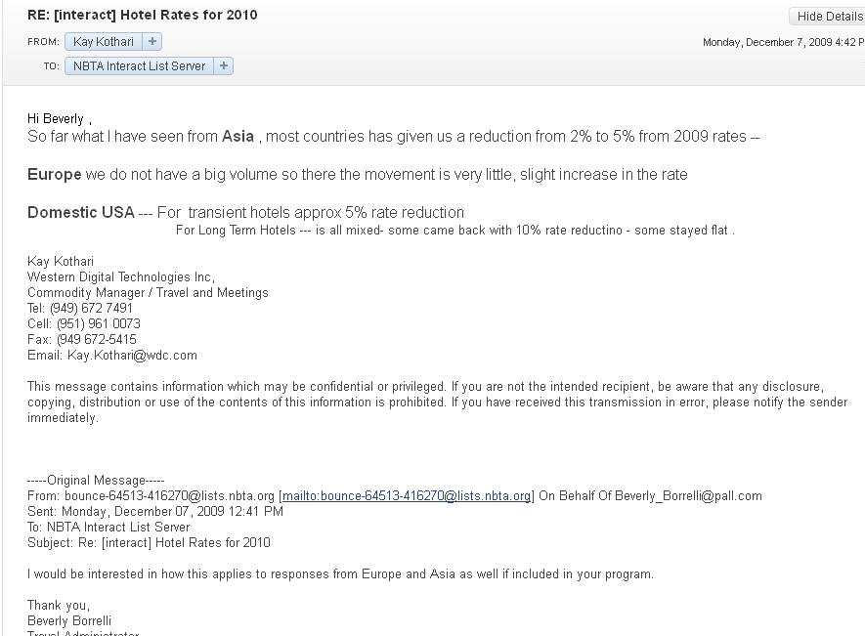

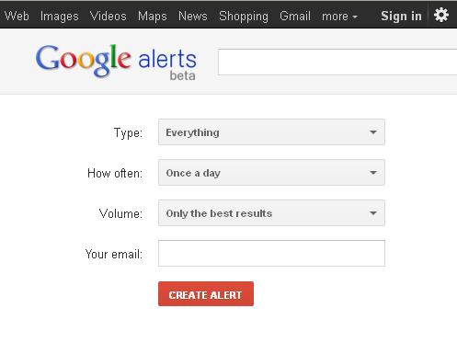
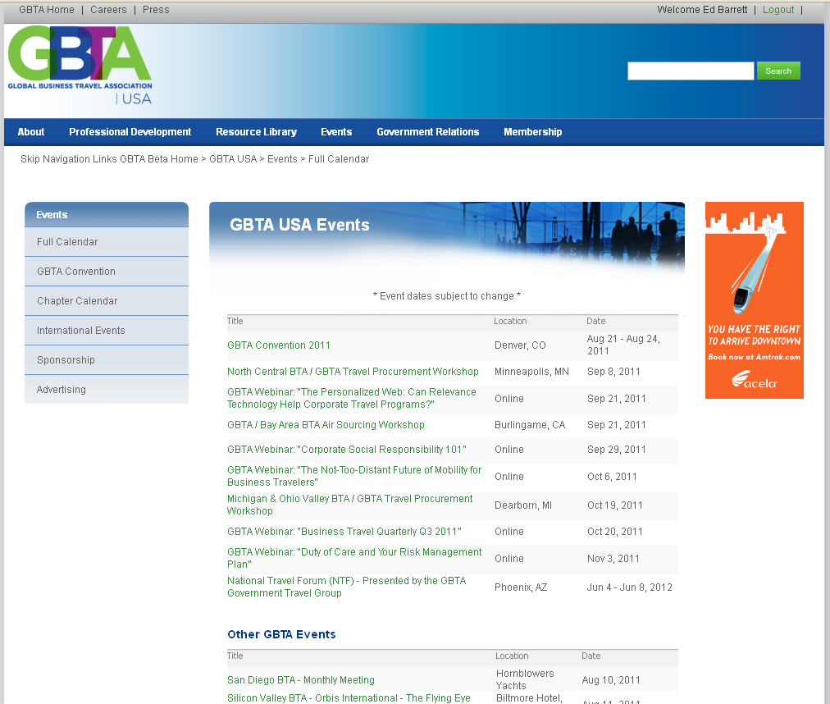
What is the GBTA Hub?
Resource library
ListServ
Member Directory
Industry news
Google alerts
Calendar

Slide 7




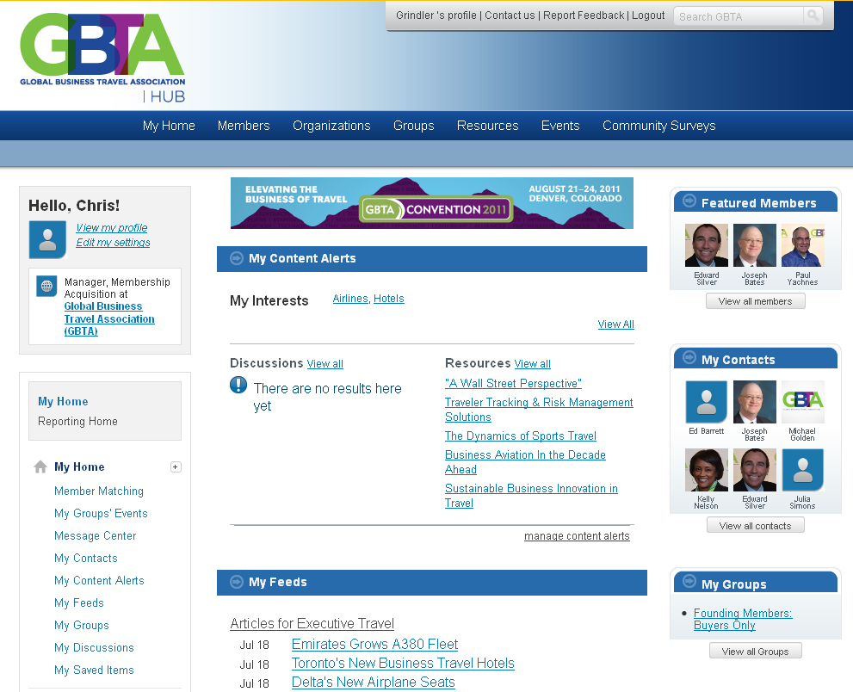



Networking
Notifications
Discussions
Matching Engine
Research
Industry News
Events
Live Polls

Slide 8
A Dynamic Year Of Events On The Horizon
    The GBTA Masters Program
    Washington, DC (February 5-6)
    GBTA Mexico Conference
    Mexico City (March 6-8)
    Global Business Travel Magazine Unplugged
    New York City (March 18)
    GBTA Canada Conference
    Toronto, (March 25-27)
    GBTA Convention
    San Diego (August 4-7)
    GBTA Europe Conference 2013
    Prague (September 24-26)

Slide 9
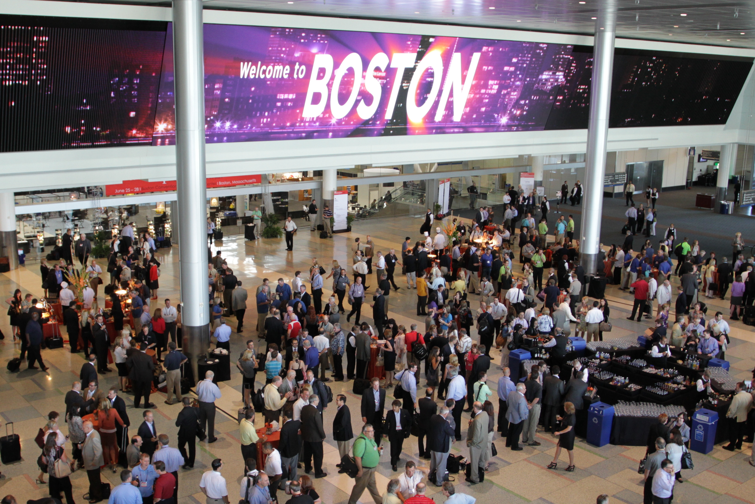

GBTA Convention 2013
San Diego, CA | August 4-7
Theme: “no boundaries”
88% of Exhibit Space Already Sold
  More square footage has already
  been sold than total square
  footage on site in Denver
Registration & Housing Opening in December
  gbta.org/convention

Slide 10

GBTA Research
Compelling Research Studies
Resource Library
Benchmarking Tools
Industry White Papers
Daily News Brief

Slide 11
Recent Research
Fiscal Cliff Shock Scenario
  Issued 11.15.12
  What would happen to business travel if we go over the cliff
Hurricane Shock Scenario
  Issued 10.26.12
  How would Hurricane Sandy impact business travel
Both research studies received tremendous media coverage

Slide 12

GBTA Education & Career Advancement
GBTA Academy
Career Center
Professional Development
Webinars

Slide 13
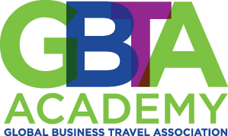
Mission:
Elevate the profession of business travel management through the organizations’ commitment to quality education, training, and research.
gbta.org/academy

Slide 14
GBTA Academy
Leader Level
Geared toward senior professionals in travel management
Manager Level
Designed for managers and directors
Associate Level
Recommended for assistant and coordinator positions
An education through the GBTA Academy is reputable, renowned and revitalizing, and it is being brought to you around the world.

Slide 15
Global Travel Professional (GTP) Certification
177
  Computer-based examination
    150 multiple choice questions
  Eligibility requirements: 3-years business travel experience
  3. First Test Date: 2012 Convention in Boston
    Free to all CCTE, SMMC, CGTE and GLP holders
  4. Re-Certification Program put in place in 2013

Slide 16
GBTA Government Relations
  SMARTER AND SAFER PASSENGER SCREENING
    PreCheck and Global Entry – Risk-based – Safe, Fast and Efficient
    Unnecessary Procedures Reduce Business Travel Due to the “Hassle Factor”
  FAIR TAXATION AND FEES
    Local, State and Federal Taxes Must Benefit Travelers
    Discriminatory Travel Taxes Hurt the Industry and Economy
  INFRASTRUCTURE: EFFICIENT AND ACCESSIBLE
    Air Traffic Control Modernization Reduces Flight Delays and Cancellations
    Visa Improvements Make Business Travel Easier

Slide 17

Global Advocacy
Traveler Safety, Security and Privacy
Health of Business Travel Industry
Ease of Travel/Access
Efficient Travel Infrastructure
Fair Taxation and Fees

Slide 18

No Hassle Fly Act…
U.S. House Bill to Eliminate Repeat Screening of Checked Bags from Pre Clearance Airports
  Toronto, Ottawa, Dublin
GBTA ACTION ALERT Resulted in Over 450 Letters to House and Senate Members Urging Support
Bill Passed House
Bill Passed Senate

Slide 19
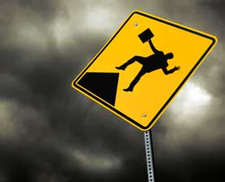
Increasing Aviation Security Fee
GBTA Concerns
  Increase Cost of Airline Tickets
  Decrease Business Trips
Congressional Budget Fight
  Opposed by House
  Supported by Senate
FY 2013 Administration Proposal
  Included in Opening Fiscal Cliff
GBTA ACTION ALERT Resulted in Over 400 Letters to House and Senate Members Urging Opposition

Slide 20

Fall 2012 – Greatest Risks
Aviation Security Fee Increase
Sequestration/Deficit Reduction Targets
Funding Decrease for PreCheck, NextGen, Global Entry and Visa Reforms
Elimination of Tax Benefits/Deductions
TRAVEL

Slide 21
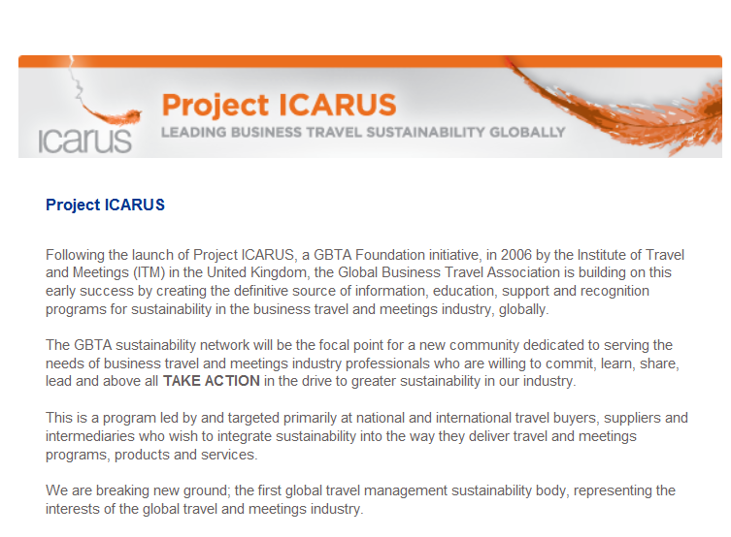
GBTA Expands Project ICARUS
Industry’s first sustainability project to receive investment to provide tools and guidance on sustainability and duty of care issues globally.

Slide 22


