Slide 1

Introduction to
Travel Risk Management
Presented by GBTA’s
Travel & Meetings Risk Management Committee
John Rose, President
Business Travel Services
Travel Guard North America

Slide 2
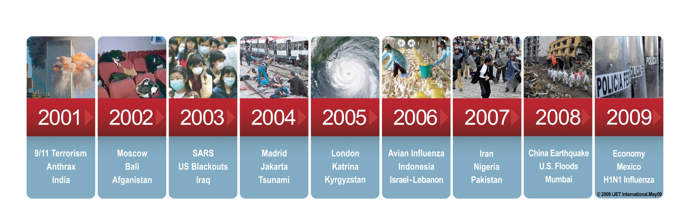
Introduction to Risk Management
Since 911, organizations have had to deal with both the perception and the reality that there are increased risks to their employees and business operations around the world
Notes:
The risks arising from natural disasters, accidents, illness, and terrorism are nothing new – they are as old as time. However, business disruptions impact more businesses globally today than ever before. (Speak about trending, not about specific travel manager responsibility yet.)
In addition, there is more media awareness today about not only the types of threats, but also their increasing frequency and severity.
We must realize and deal with the “new normal”.
JR Additional Talking Points:
Snapshot of some of the 2011 world events:
January to March – civil unrest throughout Tunisia, Egypt, Bahrain and Libya leading to a number of medical, security and travel concerns. Unrest still going on today.
February – earthquake struck New Zealand causing extensive damage
March – earthquake and subsequent tusunami struck the north coast of Japan, creating a nuclear disaster
May – E. coli outbreak yielded 3,600 cases and 40 deaths across Germany
To more recent events:
August – Hurricane Irene impacting most of the East coast causing major travel disruptions
– 5.8 Earthquake in Virginia

Slide 3
Reality Check
What are the odds?
Dying in an airplane accident = 1 in 10.87 million
(top 25 airlines)¹
Dying in a terrorist attack = 1 in 9.3 million³
Dying by choking on food = 1 in 4,293²
Dying from exposure to smoke or fire = 1 in 1,167²
Dying by accidental drowning = 1 in 1,140²
Dying in a motor vehicle accident = 1 in 84²
¹ OAG Aviation & PlaneCrashInfo.com accident database, 1985 - 2009
² National Safety Council (2004) – lifetime risk
³ National Safety Council – historical odds
Notes:
Unfortunately, the media has created a sensationalistic awareness about risk and emphasizes the worst case scenarios in the headline news. While there is a strong emphasis on terrorism and global crisis, there are many other ways that travelers can be negatively effected while traveling.
The top three things that actually happen are: weather/environment, health issues/accidents, and petty theft.
When we develop a risk management plan we must think of these more realistic issues and be prepared to address them in a plan, as well as for the being prepared for the worst case scenario.

Slide 4
Reality Check
What are the odds?
65% of international travelers report a health problem during their trip
Of these, 8% will seek medical care while traveling or immediately upon return
Notes:
Unfortunately, the media has created a sensationalistic awareness about risk and emphasizes the worst case scenarios in the headline news. While there is a strong emphasis on terrorism and global crisis, there are many other ways that travelers can be negatively effected while traveling.
The top three things that actually happen are: weather/environment, health issues/accidents, and petty theft.
When we develop a risk management plan we must think of these more realistic issues and be prepared to address them in a plan, as well as for the being prepared for the worst case scenario.
4

Slide 5
Risk Types
Risk to personnel
Risk to operations/productivity
Risk to data/equipment
Financial/legal risk
Risk to reputation
Notes:
All of the these are enterprise risk.
Examples for discussion:
Personnel: building fire, flu pandemic
Operations/Productivity: flood, power failure, supply chain failure
Data/Equipment: Data loss, computer virus, theft
Financial/Legal: executive malfeasance, patent infringement
Reputation: product failure, scandal
Generally, travel would fall under the category of “operational risk”. Meetings are a different because, in this case, all of the above risk types usually apply. The very fact the a meeting may publicize a specific date/time/place, increases the risk profile.

Slide 6
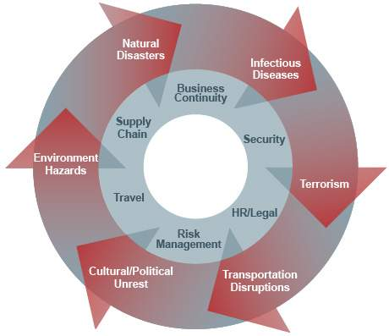
Disruptions Impact the Entire Enterprise
Driving cost:
Lost revenue
Mitigation
Liability
Response/recovery
Control and compliance
Notes:
Discuss how disruptions can impact business continuation and cost to a company.
The longer it takes you to respond to an incident, the greater the cost to the organization. The objective is to minimize cost – and the only way to do this is to address preparedness.
JR Additional Talking Points:
Egypt Crisis
Many companies and business travelers who already had full-service crisis management arrangements in place were able to get their people out of Egypt
38% of travelers said they never do any research on the country they visit
78% said they never carry emergency phone numbers – examples: personal emergency contact, company contact, agency contact, agency after-hours number, consulate, etc.

Slide 7
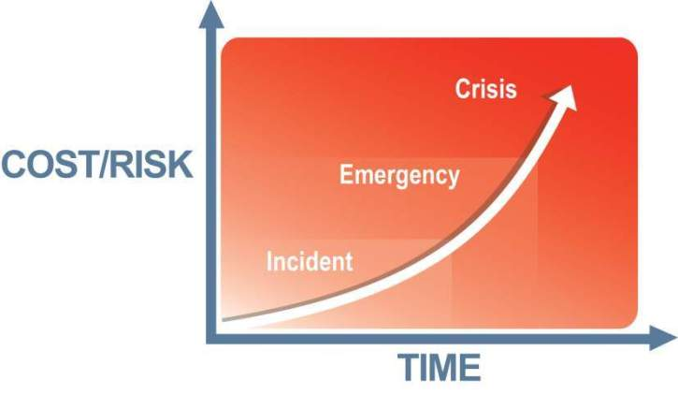
Optimizing Response Time
Reduced risk & cost = competitiveness
“Optimal response”
Notes:
Having a plan and the ability to respond to any disruption quickly can have a dramatic effect on the cost impact to your company.
Example:
A cigarette thrown into a trash can causes a fire.
If it is put out right away (throw coffee on it), then it is a minor local incident.
If the fire suppression system kicks in, people are evacuated, but the fire is put out fairly quickly, then it is an emergency, but not a crisis.
If the fire suppression system is inactive, escape routes are blocked, etc., contributing to a lack of response that results in property loss, injury, and/or death, then this becomes a crisis.
JR Additional Talking Points:
Ability to locate travelers quickly – if an incident occurs, how long would it take to determine affected travelers within the area?
If an incident occurs, who do your travelers call?

Slide 8
Defining Travel
Any time an employee leaves the office on official business
Air, hotel, rental car, train, ship
Both domestic and international travel
Driving from one facility to another
Taking public transportation
Notes:
How do you define travel? Discuss.
Unfortunately, insurance is often purchased in a vacuum without engaging travel and meetings managers in the process.
How does your travel accident insurance define “travel”? Some define it as being 100 miles or more away from your office, while others define it as any time you are away from the office on official business. Talk to your insurance people to find out where and what your insurance covers and if there are any exclusions. Insurance companies will typically offer baseline coverage to minimize their potential payout. Sometimes, for little additional cost, you can obtain enhanced coverage.
Also, some corporate credit cards include insurance coverage, so more may not be needed.

Slide 9
Why Do You Care?
Defining “Duty of Care” - the requirement to do everything “reasonably practical” to protect the health and safety of employees
Legal responsibility of an organizational
Legal statutes, past court decisions, Workers’ Compensation regulations, corporate social responsibility
Obligation to provide a safe work environment – this extends to hotels, airlines, rental vehicle, ground transportation, etc.
“Standard of Care” – if others in your industry or like-sized company are doing something to protect their staff, then your company can be held liable for not doing it
Notes:
All of the these are enterprise risk.
Examples for discussion:
Personnel: building fire, flu pandemic
Operations/Productivity: flood, power failure, supply chain failure
Data/Equipment: Data loss, computer virus, theft
Financial/Legal: executive malfeasance, patent infringement
Reputation: product failure, scandal
Generally, travel would fall under the category of “operational risk”. Meetings are a different because, in this case, all of the above risk types usually apply. The very fact the a meeting may publicize a specific date/time/place, increases the risk profile.
JR Additional Talking Points:
Information from Garry regarding UK case (it was either a channel tunnel accident or a capsized ferry called Spirit in the River Thames):
A United Kingdom inquiry, took place, where a coroner was responsible for the investigation. Coroners are like judges in the UK, and have to do an inquiry to make a professional assessment. In the coroner’s report he found the corporate body “to be riddled with ineptitude, incompetency, and causal disregard for human life.”
This was before Corporate Manslaughter Act and was considered one of the cases to start the legislation.
9

Slide 10
Travel & Meetings Risk Management Program
Proactive
_{Feedback}
Planning
Training
24x7
Monitoring
Incident
Response
Reactive
Notes:
There are two strategies to mitigating risks in travel risk management: Proactive and Reactive.
Proactive strategies encompass 4 stages:
Planning and training of human assets (employees, travelers, and expats);
Real time (24/7/365) monitoring of global situations and cultivating the intelligence of impacted destinations;
Locating impacted travelers, employees (assets);
Communicating with impacted traveler, employees (assets).
Planning/Monitoring: Strikes, civil unrest, typhoons/hurricanes – why would you knowingly want to walk into a situation with an elevated risk?
Training: Offers the highest ROI. It’s about changing behavior. (“I’m more worried about Bin Drinkin’ than Bin Laden.”)
Incident Response is identified in the Reactive strategy.
Finally, when a reaction is required (i.e. incidence response), it becomes the new baseline that feeds planning and training. Any effective system incorporates feedback to provide the input to improve and change future behaviors and outcomes. How can we change our travel policy and train to reduce risk? John’s example: Most incidents occurred in the early morning hours (2 a.m.), so they implemented a midnight curfew.

Slide 11
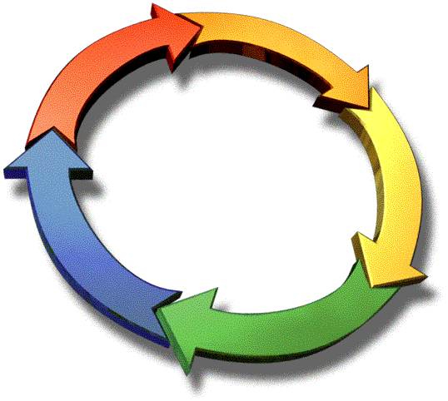
Traveler Safety Continuum
Pre-Trip
  Crisis management plans
  Policy/compliance
  Enterprise communication
  Health plan, vaccinations
Access to Intelligence
  Travelers
  Management (push)
  Assess risks/set ratings
  Pre-trip (pull)
  During travel
Training
  All employees
  Management team
  Personal protection
  Kidnapping & threat
  Country/region specific
Track Employees
  Employee profiles
  Automated and verified
  Real-time alerting
  Communication options
Hotline
  24 x 7
  One call
  Company-specific protocol
  Travel, security, health
Security Service
  Executive protection
  Escorts
  Guards
  Evacuation
Medical Service
  In-country, Western-quality care
  Evacuation
Notes:
Travel Risk Management is “a process, not an event”.
Discuss the components of the continuum above, with emphasis on reviewing each component on a regular basis to keep the process current and frequently communicated within the appropriate management circles, as well as to the travelers.
JR Additional Talking Points:
Travel Risk Management Plan should protect all of your employees, international travelers, domestic travelers, expatriates and contractors
i.e. East Coast earthquake– bad things don’t just happen when you travel outside of the US
i.e. Hurricanes – travel disruptions
Good information to collect:
Location
Duration
Purpose of Trip
Number of employees traveling on same trip
Sojourn trips

Slide 12
Cross-Functional Support Critical to Success
Organization
Travel
Department
HR/Legal
Security
Department
Medical
Department
ERM/
BCP
Global data consolidation and reporting
Compliance monitoring
Pre-trip training
Pushed alerts
Standards of care
Auditable systems
Risk disclosure
Lower liability
Policy and procedures
Corporate insurance programs
Risk assessment and predictive intelligence
Incident notification
Crisis and evacuation plans
Coordinated response
Pre-trip health planning
Immunizations
Medical assistance and evacuation for international travelers
Plan development/ implementation
Monitor assets at risk
Notes:
Use this slide to discuss how company departments can participate in the process of developing a plan.
Who should be driving this?
As travel manager, you are an important component and likely to be the champion to drive the process, but you can’t do it alone. Communication within all cross-functional areas of the company is critical to having a successful plan.
And getting buy-in from management is essential.
(The resource checklist can help participants begin to think about their internal and external resources.)

Slide 13
Benchmarking Your Program
Travel Risk Management Maturity Model (TRM3)
The TRM3TM model establishes a basis for assessing a travel risk management program
The model describes the maturity of a program based on key process areas (KPAs) that are required to implement and support a successful program
Provides guidance on how to improve an organization’s program over time
Free resource for GBTA members on the website
TRM3 is a trademark of iJET International, Inc.
Notes:
Read.
How do you figure out where you are?
How to you figure out where to focus your limited resources (both money and manpower)?
JR Additional Talking Points:
In 2009, more than 3.5 million international trips were made by employees 25% of which were to high or extreme risk destinations
According to the Visa2008 Global Procure-to-Pay and Commercial Card Best Practices Study, centralizing travel management can reduce costs by as much as 20%

Slide 14
Measuring Your Program Maturity Level
Optimized (5)
Program integrated throughout organization.
Managed (4)
Metrics collected and reviewed. Cross-organization support.
Proactive (3)
Consistent execution of travel risk management processes.
Defined (2)
Basic travel risk management policies defined and documented. Primary focus on incident response.
Reactive (1)
Ad hoc. Few policies. Chaotic in the event
of an emergency.
Notes:
Level 3 is the acceptable baseline. This is as far as you, as a travel manager, can go on your own.
Level 4 gets into a larger corporate risk management program.

Slide 15
TRM3TM – 10 Key Process Areas (KPAs)
Policy/Procedures
Overarching KPAs
Management KPAs
Infrastructure KPAs
Training
Risk
Assess-ment
Risk
Disclosure
Risk
Mitigation
Risk Monitoring
Response
Notification
Data Management
Communication
TRM3 is a trademark of iJET International, Inc.
Notes:
These KPAs drive the program, and each can be running at a different level.
This standard model can be applied to both travel and meetings and event risk.
JR Additional Talking Points:
If you have no plan in place start with Response and work into Risk Assessment. Make sure you have an 800 number for travelers to call for assistance.

Slide 16
Key Process Areas - Overarching
Policy & Procedures: The process of developing, implementing, and maintaining your policies and procedures
Training: Three specific areas should be addressed – traveler training, traveler advisor training, crisis management team training
Notes:
Now let’s begin to review briefly each of the KPAs in the TRM program.
Policy & Procedures: This is more than just having them. This is a continual process. You should perform an annual review of your policies, procedures, insurance, etc.
Training: There is typically a training gap when it comes to meetings. Usually, the only person to receive training is the planner/advisor. Seldom (if ever) are the attendees trained. Training must also be a continual process. When it comes to crisis management team training, when is the last time the team got together? Do you do drills or table-top exercises?

Slide 17
Key Process Areas – Risk Management
Risk Assessment: Ensure that each trip or assignment is evaluated for risk as part of the decision process
Risk Disclosure: Ensure that each stakeholder understands the nature of the threat, its impact, and what should be done to mitigate the risk
Risk Mitigation: Strategies and solutions that will result in a level of risk that is acceptable to all parties
Risk Monitoring: Around the clock (24/7) process to monitor the current threat environment for changes
Response: Provide travelers with a process for reporting problems and getting assistance
Notes:
Risk Assessment: Example of Bruce going to the Antarctic. He will need appropriate clothing, food, shelter. Does he realize that it’s going to be really cold?
Risk Monitoring: There is a storm coming. Do we pull Bruce out or deal with the storm? When monitoring indicates that there is a need to act, are you ready to respond?

Slide 18
Key Process Areas - Infrastructure
Notification: Ensure that the appropriate people are informed of any relevant travel risk information before, during, and even after a trip
Data Management: The overall process of identifying, collecting, storing, accessing, and maintaining travel risk data
Communication: Ensure that each constituent understands the program and his/her role in it
Notes:
Notification: I know about some bad things. Who do I tell and how? What if the person I need to contact isn’t there? Is there a backup?
Data Management: If only 80% of the travel data is collected and 20% is missing or inaccurate, that 20% is likely where the problem will be. Contact information is often an issue. Do you know where they are staying? Do you know who they are visiting?
Every time something happens in the world (earthquake, storm, bombing) that is an opportunity for you, as a travel manager, to reinforce what should be done should that type of event occur.

Slide 19
Top 10 Reasons Things Fail . . .
How do you avoid them?
Notes:
19

Slide 20
#10
Company does not know what to do in an emergency
Don’t be reactive
Get a basic plan in place and make sure you know where to get help
Notes:
JR Additional Talking Points:
Do not wait for an emergency to establish policies and revisions
Recognize that there is a need
Obtain buy-in form executive leadership
Develop & implement policies and procedures – they must be flexible to adapt to specific crises
Select providers that can assist the organization during a crisis, at Travel Guard we provide 24/7 assistance and in most cases act as the first point of contacts for a lot of our accounts. Need to establish this Single Point of Contact.

Slide 21
#9
Out of date contact numbers
Get contact numbers (cell, home, office, email, IM, etc.) for all the people that you would need in an emergency
Periodically have them updated
Notes:
JR Additional Talking Points:
Assistance providers can help you manage this and you will want to build this into your travel risk management plan.
For example, most providers provide a Secure Members Website where you can store emergency contact information for those key individuals that should be contacted during an emergency.
Having this information in a central location makes it accessible to your travelers and in most cases this information can be automatically updated into your Assistance provider’s database so that the information is readily available in the event of an emergency.

Slide 22
#8
Primary and backup person are not available
This happens frequently
Try to have multiple backup contacts
Think about people who are normally available
Notes:
JR Additional Talking Points:
Important to work with an Assistance Company that is available 24/7 to serve as your single point of contact.
Assistance company will be the liaison between the traveler and primary contacts within the company.

Slide 23
#7
Cell phones don’t always work
We are becoming totally reliant upon cell phones – just try to find a pay phone
Employees should keep a calling card, know how to use text (SMS) messaging, and have a satellite phone for rural assignments
Notes:
JR Additional Talking Points:
Important to utilize multiple methods of communication, which can be coordinated through an Assistance or Security provider.
Egypt Crisis: internet and mobile phone communications were shut down
Travel Guard and our Security provider were able to use on-the-ground relations and satellite phones to locate our clients
Haiti Earthquake: situation was much more severe, cell towers were destroyed
Travel Guard used other means of communication such as Facebook and Skype

Slide 24
#6
Third-party response resource does not know what is going on
Talk to your vendors
Include them in your planning; run exercises and drills
Notes:
JR Additional Talking Points:
Communication and Training is key – need to make sure that everyone is familiar with the corporate crisis management procedures and what to do in an emergency.
By centralizing everything to a single point of contact will make the communication and coordination more manageable during an emergency.
Key participants for a successful program include:
Travel Manager / Department
Security
Legal
HR
Executive leadership

Slide 25
#5
No response resources retained
Who would you turn to in the event of a kidnapping? What about a threat against an employee? A medical emergency? A car accident? An incident while on vacation?
Make a list of incident types and answer the question “Who would I turn to?”
Notes:
JR Additional Talking Points:
Access to 24/7 Emergency Assistance
Business travelers account for more than 15% of all outbound travel (U.S. Department of Commerce)
According to the US Travel Insurance Organization – it’s more important than ever for companies to carefully assess their travel-related insurance needs. Policies for corporate travel are usually customized to meet each company’s needs.
Comprehensive policy should include:
Travel Risk Management, providing international intelligence briefing and security (travel alerts)
Assistance services
Emergency security to evacuate employees in times of turmoil or potential situations
Medical treatment for accidents and illnesses
Baggage loss or delay, including business equipment
War Risk policies which provide special coverage for employees work potentially dangerous areas
nce provider to assist in these types of emergencies

Slide 26
#4
Protocols are not maintained
Companies need to periodically review their plans and protocols – at least annually
Notes:
JR Additional Talking Points:
It is important to review plans frequently and make updates as needed throughout the year.
Recommended that your do a full review of your travel policies and procedures on an annual basis – can work with travel risk consultants to assist with providing:
in-depth assessment of current travel policies
conduct interviews with key stakeholders (HR, Security, Risk Managers)
perform gap analysis and compared to industry best practices
provide recommendations for areas of improvement and implementation.

Slide 27
#3
Protocol or procedure is too complex
Many times the plans and procedures are far too complex; look to streamline the process
In the event of an emergency, you will only have time and bandwidth for the basics
Notes:
JR Additional Talking Points:
Keep things simple – provide travelers with cards that have emergency contact information listed that they can carry with them so they know who to call and what to do in the event of an emergency.

Slide 28
#2
Inconsistent skill level within the team
Crisis and emergency management is not the core competency of most businesses
Get training for the core team that will be called upon to deal with an emergency
Notes:
JR Additional Talking Points:
Developing an integrated set of policies, procedures and infrastructure, with the appropriate leadership oversight will reduce financial exposure, address Duty of Care issues and allow senior leadership team to focus their time on other business needs.
Assistance companies will provide training and support in building a these policies, procedures and infrastructure.

Slide 29
#1
Cost sensitivity delays response
Deal with where the funds will come from and who will pay BEFORE the event
A delay in response increases costs and can even result in loss of life
Notes:
JR Additional Talking Points:
By having your BTA and Assistance through the same provider this becomes a non-issue – coverage, assistance and claim handling will be managed and seamless to the traveler.
In other cases, work with your Assistance provider to set up a Letter of Indemnity which provides authorization for payments up to a certain $ amount in the event of an emergency.

Slide 30
Summary
Your program must:
Identify and evaluate the risk
Identify your resources
Set an acceptable level of risk
Develop a plan for mitigating the risk
Educate and communicate the plan
Monitor and benchmark the results
Notes:
Often, the traveler will be complacent and won’t be concerned, but perhaps the corporation might (or should).
You are the last bastion of defense to make sure that bad things don’t happen!
Your target should be a Level 3 baseline program.
JR Additional Talking Points:
United Kingdom had 6.5M crimes reported worldwide in 2010
Employee tracking
Training
Communication plans
Crisis management plans
Communications & Training – make sure that employees know who to call if an emergency would occur – Single Point of Contact, communicate process & procedures, alert messages, employee tracking

Slide 31
Resources
Travel Risk Management Maturity Model (TRM3TM)
GBTA Foundation’s Managed Travel Index & Benchmarking Tool (includes travel risk management self-assessment) – now FREE to GBTA members
Certified Corporate Travel Executive (CCTE) Core Week II module
Webinars
Further resources being developed by GBTA’s Travel & Meetings Risk Management Committee
Notes:
Don’t forget to provide travel manager resource checklist.

Slide 32

Questions?

