Slide 1
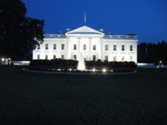
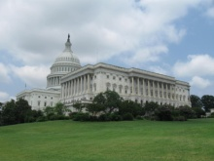
GBTA Legislative Summit - DC
9th Annual Legislative Summit
GBTA BRINGS RENTAL CAR TAXES AND TRUSTED TRAVELER MESSAGES TO CAPITOL HILL
  Members seek : end to Excise Taxes, Progress toward a Trusted Traveler Program, and FAA Reauthorization
Tuesday - Packed Agenda
  Featured speakers from the Transportation Security Administration (TSA), the U.S. Department of Homeland Security (DHS), and the U.S. Congress
  Tuesday Morning Session
    GBTA’s Executive Director and COO Michael W. McCormick providing attendees with an overview of GBTA’s Business Travel Index ™ and the current economic outlook
    McCormick explained how investing in business travel is good for economic growth and encouraged attendees to ask Congress to support key business travel initiatives
      Passing the Federal Aviation Administration (FAA) Reauthorization and Reform Act of 2011
      Implementing a trusted traveler program,
      Ending discriminatory state taxes levied on rental car consumers.
  Paul Leyh, TSA’s Transportation Sector Network Management (TSNM) General Manager for Commercial Aviation
    Discussed issues TSA is addressing such as checkpoint photography, pat-downs and overall security for passengers
    The further we move away from 9/11, the easier it is to believe the threats against the U.S. have lessened but TSA is being as vigilant as ever. The threats are still real, severe and sophisticated and we are looking for new and better ways to keep the public safe while getting them through security as quickly as possible.”

Slide 2
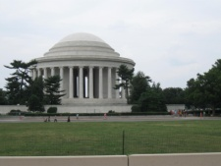
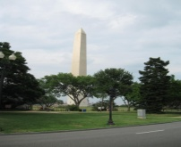
GBTA Legislative Summit - DC
  Brian Rothery, director of Government and Public Affairs, Enterprise Holdings, Inc.
    Discussed the negative effects discriminatory rental car taxes have on consumers.
    Rothery encouraged attendees to tell their Representatives to sign on as an original co-sponsor to “End Discriminatory State Taxes for Automobile Renters Act of 2011 (EDSTAR).” The bill, soon to be introduced, proclaims that excise taxes on car rental consumers are unwarranted and would enforce a permanent halt on any new taxes.
  Tuesday Afternoon Session
  GBTA members headed to Capitol Hill to hear from Nelson Peacock, Assistant Secretary, Office of Legislative Affairs
    Discussed the department’s legislative priorities, including border protection, cyberspace safety and continuing the balance of security and travel.
    Senator Michael Bennet (D-CO)
    Discussed the difficulties facing Congress on budget and deficit issues but congratulated the crowd on taking the time to come to Washington, D.C. to have their voices heard..
  Tuesday Evening
    Concluded with POLITICO Chief White House Correspondent Mike Allen delivering the dinner keynote.
    Allen entertained the crowd with political stories from various past presidential campaigns and predictions for the 2012 elections as well as the current political landscape.

Slide 3

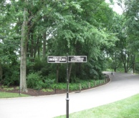

GBTA Legislative Summit - DC
  Wednesday Morning Session
    Rep. Steve Cohen (D-TN), co-sponsor of the EDSTAR bill
    Warned attendees of the growing crisis of discriminatory taxes on rental cars.
    Taxes are harmful on many levels, especially to low income households.
    Pledged to continue working on getting the EDSTAR bill enacted.
  Over 100 GBTA members headed to Capitol Hill to meet with members of Congress.
    These industry advocates serving as the voice of the business travel industry delivered the message
    “Business Travel is vital to the Nation’s economy”
      Connected the dots on how
        enactment of smarter air passenger screening
        ending discriminatory taxes on rental car consumers
        and passage of the FAA Reauthorization Act
      are important to business travel and thus important to the Nation’s economy and job growth.

