Slide 1




















Thank you 2021 MBTA Sponsors!
Diamond
Platinum
Gold
Silver
Bronze
Copper

Slide 2
GBTA | Michigan Chapter
May 6, 2021

Slide 3

Welcome!
Today’s Meeting is worth 1 credit for GTP certification
Notes:
(SOMEONE TO PASS MIC TO NEW MEMBERS AND GUESTS)
Hello!
I extend a warm welcome to you all – thank you for being here today!
Let’s take a moment to officially welcome our new members and guests –
if you are a new member or visiting us today, please stand.
WAIT FOR ALL TO STAND
A microphone is being passed – please tell us your name, your company name, and why you’ve joined or are visiting today.
Thank you for being here!
CLAP!
You may be seated.
HAVE BOARD MEMBERS STAND!
Please see one of us to talk about getting fully engaged in MBTA.
Today’s event is worth 1 credit for GTP certification

Slide 4
Agenda
  1:00 PM Welcome!
  1:05 PM Confusion And Controversy: What Documents May Be Required To Travel
  1:45 PM Q & A
  2:00 PM Presentation by MBTA Platinum Sponsor, ALTOUR
  2:10 PM MBTA Business Meeting
        Chapter Updates
        Committee Updates
  2:25 PM Prize Drawing
  2:30 PM Meeting Adjourned
Notes:
Here’s today’s agenda and you’ll find one at your table.
Please be sure to review the back of your agenda and here on the screen to see our 2020 sponsors.
Without the generous support of these companies, we would be unable to support our chapter offerings, especially our scholarships.

Slide 5
Thank you 2021 MBTA Sponsors!
Diamond
Platinum
Gold
Silver
Bronze
Copper

Slide 6
Reminder! Upcoming 2021 Meetings & Events
June/July – MBTA Member Summer Event
This is our FIRST planned in-person meeting for 2021
Location: TBD
August TBD – Virtual Meeting
September 16 – MBTA Meeting (Tradeshow/Annual Meeting)
Location: Greater Detroit Area
October TBD – MBTA/OVBTA Education Day
Location: Greater Detroit Area
November 17-19 – GBTA Convention, Orlando, FL
December 2 – Michigan Chapter Holiday Meeting & Charity Auction
Location: Greater Detroit Area
* Dates subject to change

Slide 7
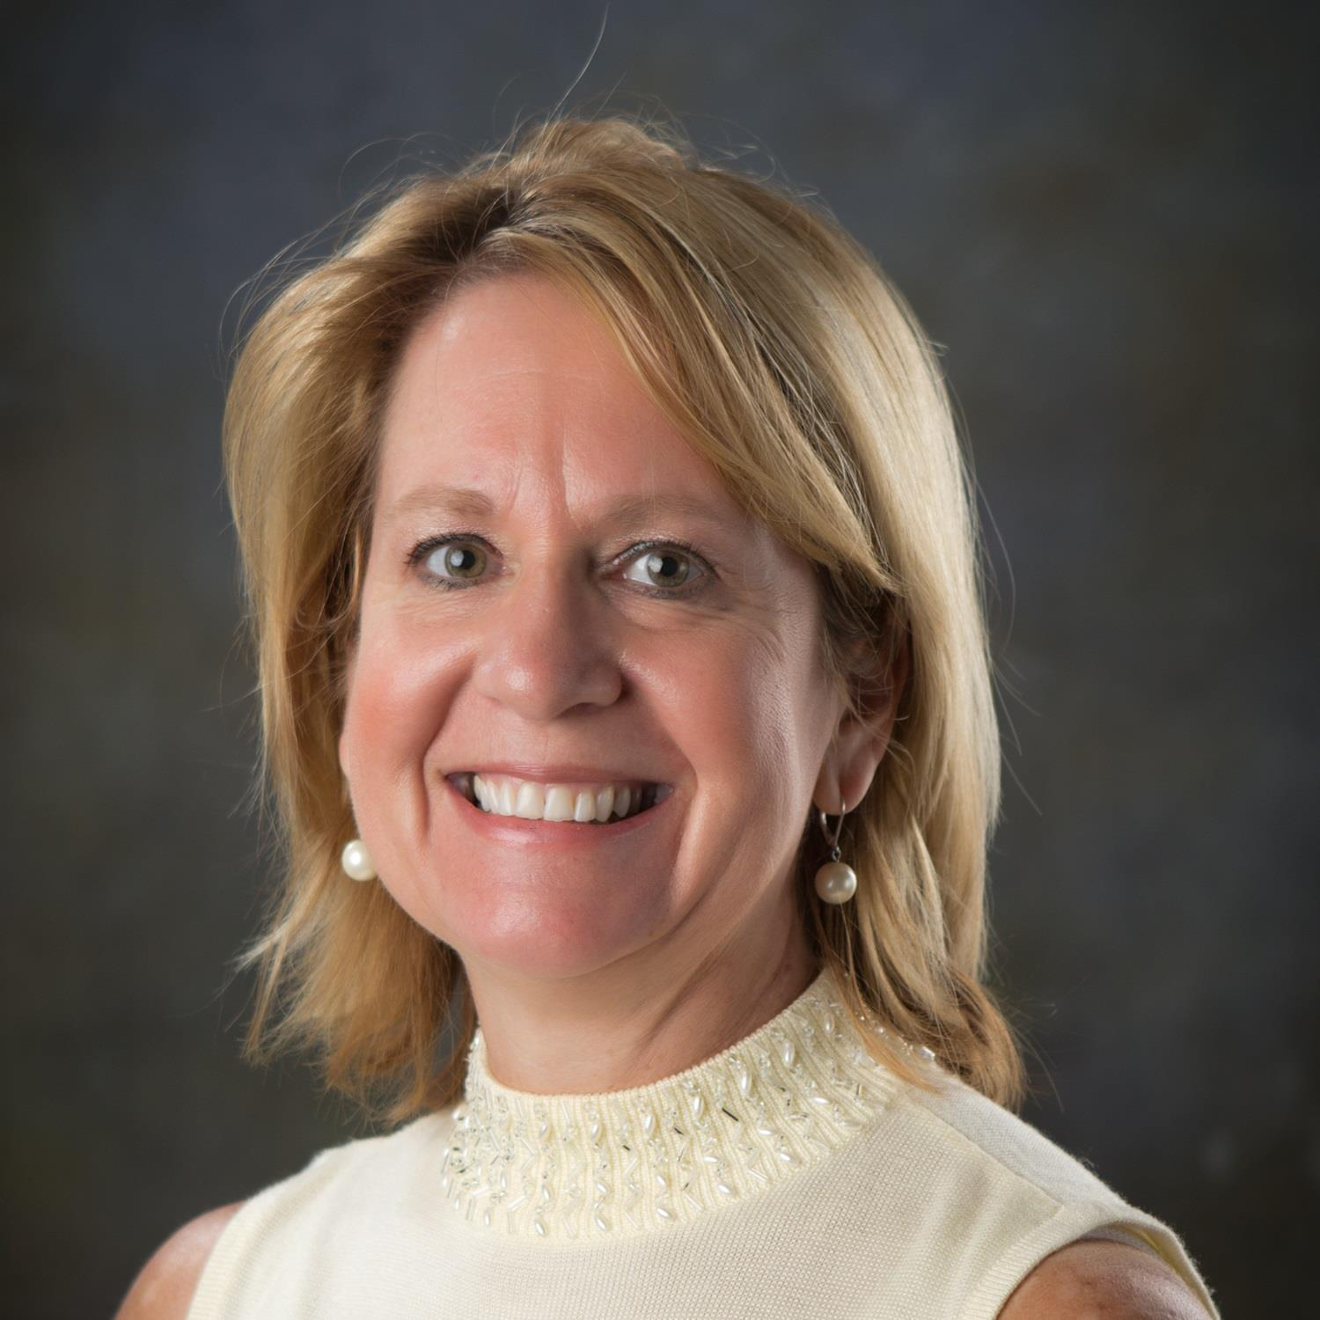

Today’s Sponsor: ALTOUR
Lisa M. Hoehn, CCTE, GTP
Senior Vice President
Global Account Management

Slide 8
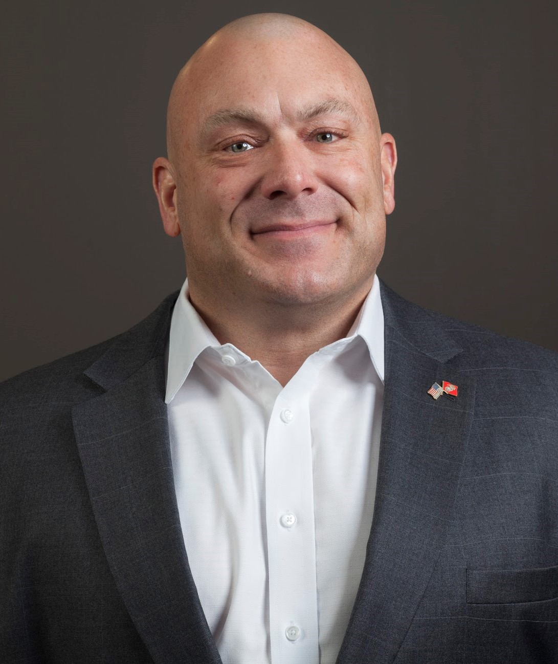
Confusion And Controversy: What Documents May Be Required To Travel
John Rose
Chief Risk & Security Officer

Slide 9
PLACE HOLDER
ALTOUR SPONSOR PRESENTATION

Slide 10
Business Meeting
Vice President’s Opening Remarks and Updates
Jenny Baumann, MBTA Vice President 2021/22
  Call to order
  General Updates
  Committee Updates

Slide 11

Follow Us On Social Media
Facebook: https://www.facebook.com/MichiganBusinessTravelAssociation
Twitter: https://twitter.com/MBTAMichigan
LinkedIn: https://www.linkedin.com/groups/3178147/

Slide 12
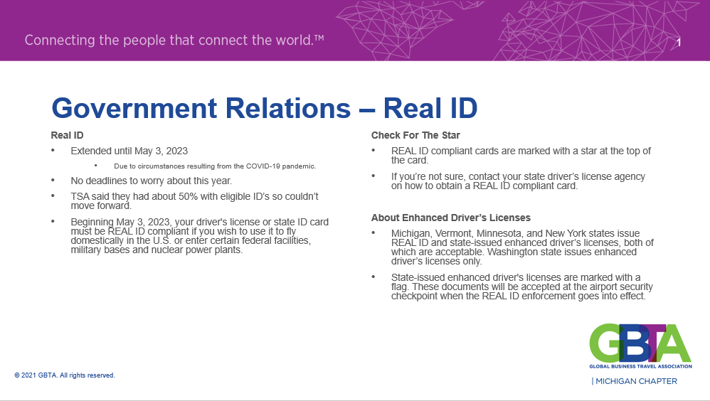

Slide 13
Thank you 2021 MBTA Sponsors!
Diamond
Platinum
Gold
Silver
Bronze
Copper

Slide 14
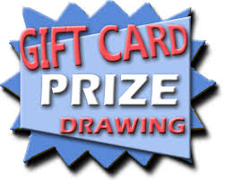
Prize Drawing!

Slide 15

Please complete the survey later today!

Slide 16
Meeting Adjourned
Next Event:
June/July – MBTA Member Summer Event
This is our FIRST planned in-person meeting for 2021
Location: TBD

