Slide 1

GBTA 2012
Government Relations Agenda
Patty Higginbotham
Vice President, Government Relations
and General Counsel
April 18, 2012

Slide 2
What We’ll Talk About Today…
  Advocacy – Why It Makes a Difference
  GBTA Priorities
  2012 Legislative Symposium
  Washington Politics
  Chapter Challenge/PAC
  Next Steps

Slide 3
GBTA Represents the Collective Voice of the Business Travel Industry in Washington, D.C.
  Policy, Tax and Funding Decisions Made by Congress and the Administration impact the Success of the Industry
  Educating Members of Congress About the Industry and How It Drives the Economy and Jobs Is Essential
  GBTA Member Support Is Key!
  YOU CAN MAKE A DIFFERENCE

Slide 4
GBTA Influencing the Debate
Testified On Discriminatory Rental Car Taxes At House Judiciary Committee Hearing (February 2012)
Meeting With Key Congressional Staff To Support A Long-term FAA Reauthorization Bill/NextGen and Key Funding (Ongoing)
Supporting Pending Bills To Stop Local Car Rental Taxes And Expand The Visa Waiver Program (Ongoing)
Supporting Expansion And Sufficient Funding For TSA PreCheck, CBP Global Entry (Ongoing)
Supporting National Travel And Tourism Policy That Recognizes Importance Of Pro Business Travel Policies (Ongoing)
Met With Key Airport Directors About Business Travel Priorities And Airport Issues (February 2012)
Joined Coalition Letters Opposing EU Emissions Trading Scheme (January/February 2012)

Slide 5
GBTA and Business Travel Industry
WINS
FAA Reauthorization
  Long-term, Stable Funding for Safety Programs
  Acceleration of NextGen Implementation
  Additional Passenger Protections
  No PFC Increase
Expansion of TSA PreCheck
  At Least 28 Additional Airports in 2012
Expansion of CBP Global Entry
  At Least 12 Additional Airports in 2012
  Pilot Program Made Permanent
No Security Fee Increase/No New Departure Fee
Visa Improvements
  Executive Order Expediting Application Process/Adding VWP Countries

Slide 6
Business Travel Industry:
Potential 2012 Risks
Aviation Security Fee Increase/New Departure Fee
Insufficient Funding for TSA PreCheck and CBP Global Entry
Curtailment of Government Travel/Meetings
Erosion of Business Travel/Meetings Deduction
Delay in NextGen Implementation
Increased State/Local Rental Car and Hotel Taxes
More International Emissions Taxes
And, Of Course, Economic Woes…

Slide 7
GBTA 2012 Priorities
  Safe, Fast and Secure Passenger Screening
      Expand/Fund TSA PreCheck and CBP Global Entry
  Fair Taxes and Fees
      No Fee Increases or New Fees
      Stop Discriminatory State and Local Travel Taxes
  Efficient and Accessible Travel Infrastructure
      Accelerate NextGen – Reduce Flight Delays
      Expand Visa Waiver Program/Improve Visa Processing

Slide 8
Increased Business Travel = Increased Jobs
  A Significant Increase in Business Travel During Q4 2010 Was Followed By a 658,000 Increase in U.S. Employment During Q1 2011

Slide 9

...Moving Business Travelers Faster Through Security
  Voluntary Passenger Pre-Screening Initiative
    TSA Can Focus on Higher-Risk Passengers
    Element of Unpredictability/Randomness
  Currently: Los Angeles, Dallas, Houston, Detroit, Miami, Minneapolis, and Las Vegas (Limited Checkpoint Locations)
    Expanding to 28 More Airports in 2012, including DCA, Salt Lake City, JFK and O’Hare
  Expedited Screening Could Include No Longer Removing:
    Shoes and Belt, 3-1-1 Compliant Bag from Carry-on Bag, Laptop from Bag and Light Outerwear/Jacket
  Global Entry Enrollment = PreCheck Enrollment

Slide 10

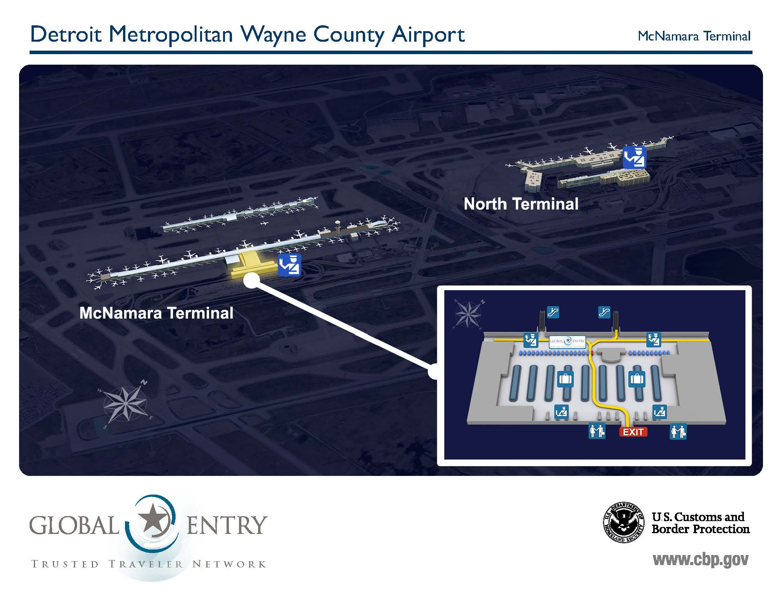
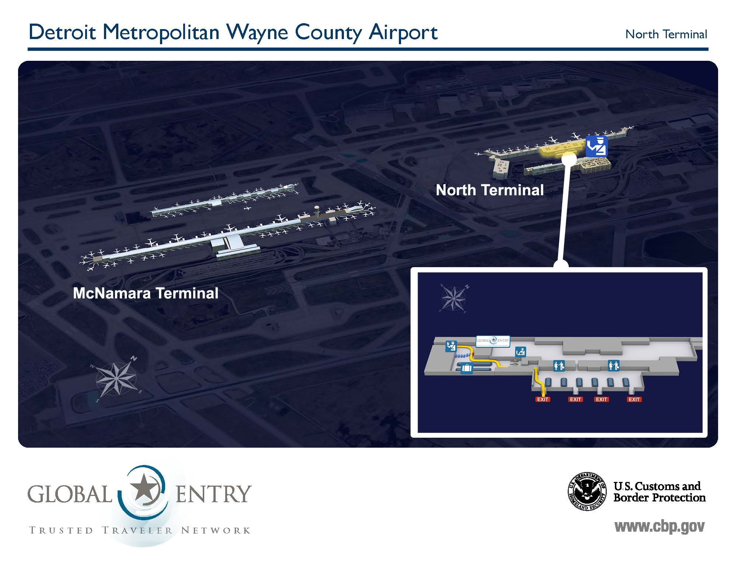
Global Entry Program
  Expedited Clearance for Pre-approved, Low-risk Travelers on Arrival in the U.S.
  Currently Operating in 20 “International Airport” Locations Within the U.S. – Permanent Program
  4 More Airports in 2012
  Global Entry Enrollment =
            Enrollment

Slide 11
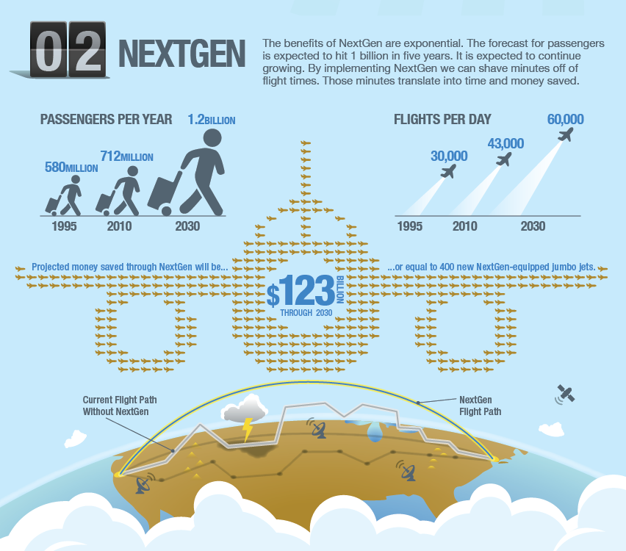
FAA Reauthorization
…Fewer Delays, Faster Flights for U.S. Business Travelers
Move from Ground-based to Satellite-based (GPS) Air Traffic Control
Faster Flights, Less Delays, Cancellations and Fuel
No PFC or Ticket Tax Increases
European GHG Trading Scheme Opposition Language
Performance Metrics and Consumer Protections

Slide 12
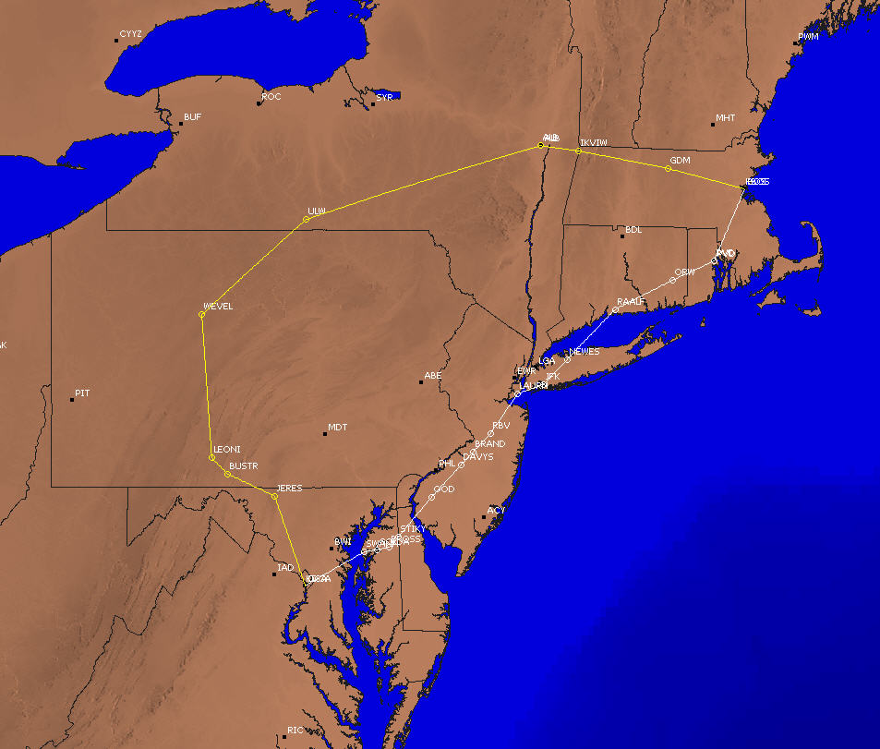
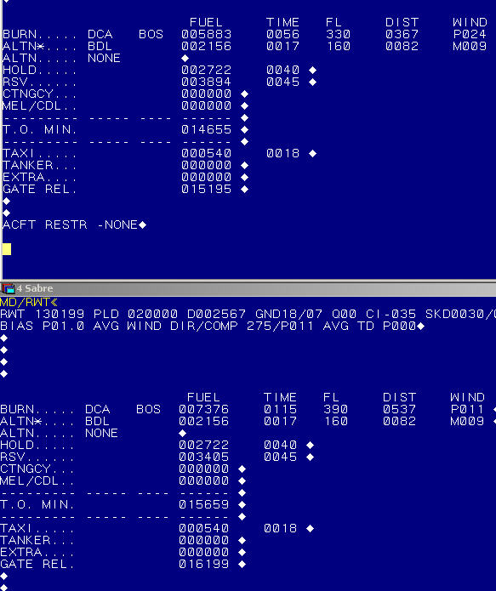
NextGen – Beginning of the End for Inefficient, Outdated Air Traffic Control
Actual Route flown
Boston, MA
Optimal Route Burn
5883 pounds
Optimal Route
Actual Route Burn
7376 pounds
Large Air Carrier: DCA to BOS
Washington, D.C.
Additional Fuel Burn Due to Reroute
1493 pounds
12
Notes:
12
12

Slide 13
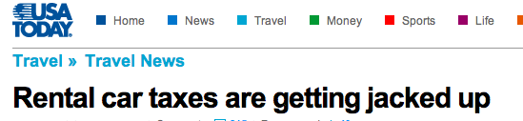
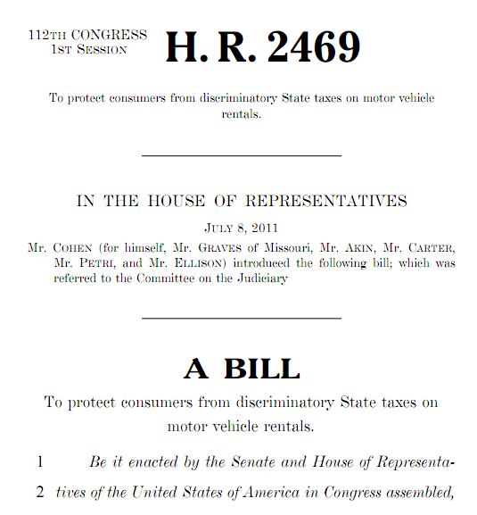
Fighting Discriminatory Car Rental Taxes...Taking on Price Gouging of Business Travelers
800% Increase Since 1990, Taxes Used for Non-Travel Purposes
Similar Protections Given to Air, Train and Bus Tickets
GBTA Testimony at House Judiciary Committee
Bad Actors – MN, NV, IL, OR, MA

Slide 14
More About Government Relations…..
GBTA Website
MOST IMPORTANT - What You Can Do to Engage, Issue Briefs, Legislative Action Center, Priorities, Resources, Chapter Challenge, PAC and More
http://www.gbta.org/usa/governmentrelations/Pages/Default.aspx
GBTA Washington Update
What GBTA is Doing in Washington to Push our Priorities and Shape Policies
http://www.gbta.org/SiteCollectionDocuments/GovernmentRelations/WASHINGTON_UPDATE_FEB12.pdf
GBTA Legislative Action Center
On-line advocacy is effective! Send a letter about key issues to your elected officials in a few clicks
http://capwiz.com/nbta/home/

Slide 15
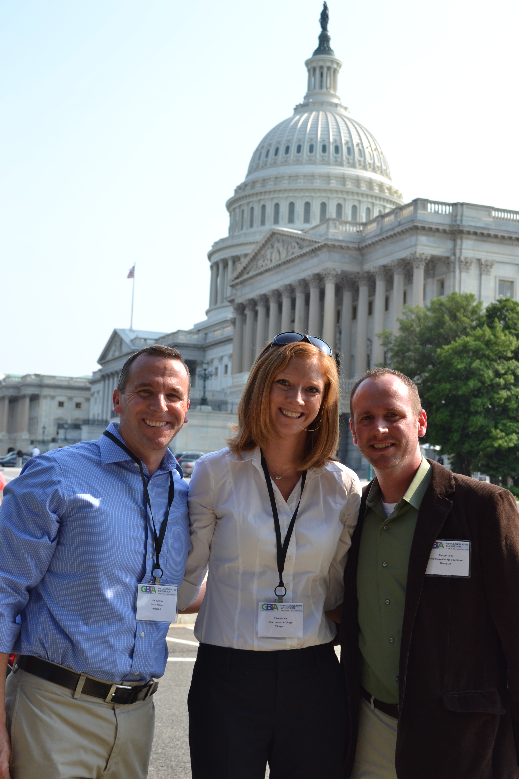
2012 Legislative Symposium
June 18-20
Washington, DC
http://www.gbta.org/LegislativeSummit/Pages/default.aspx
June 18 – Evening Reception
June 19 – Education Day
June 20 – Capitol Hill Visits

Slide 16
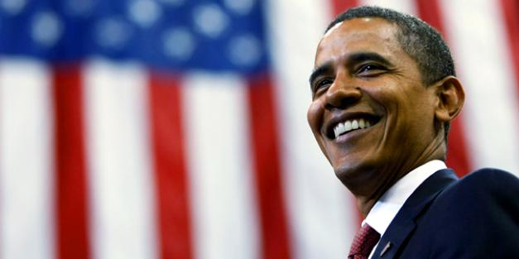
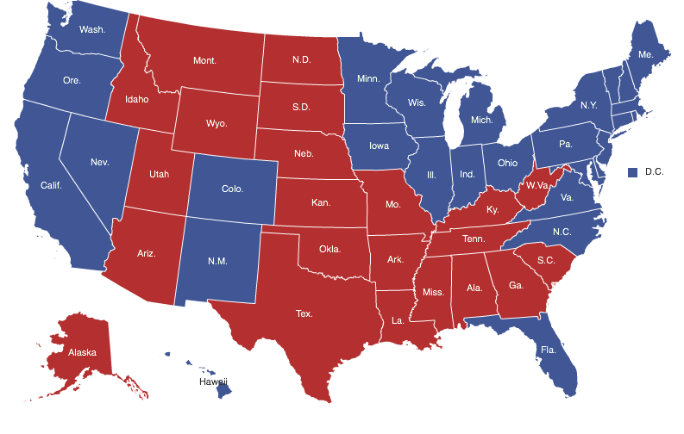
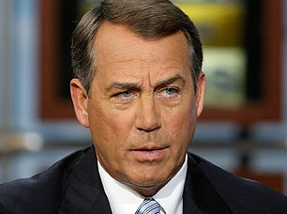
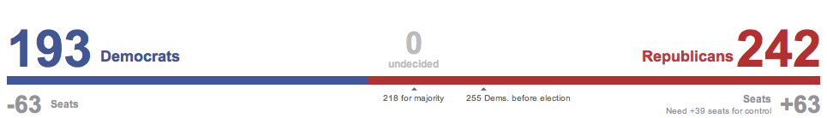
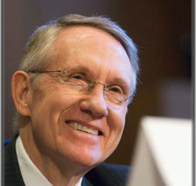
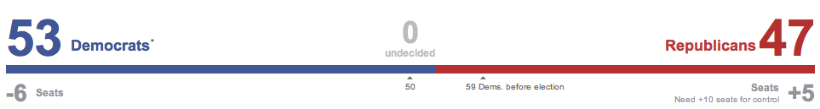
2012 Elections

Slide 17
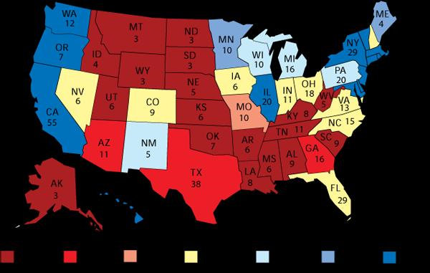
Very Few States Undecided on President

Slide 18

6th Chapter Challenge is ON!
The Voice of the Travel Industry in Washington, DC and Congressional Districts
Let Your Voice Be Heard
GBTA is Challenging Its 40 Chapters:
    Engage YOUR Elected Officials on
    Business Travel Issues

Slide 19
Chapters Completing 4 Tasks = PARTNERS
30% of Membership Send a Communication to an Elected Official Through the Legislative Action Center
Invite an Elected Official to Speak at a Chapter Meeting or Host a GBTA Government Relations Focused Meeting
    Become Eligible for $500 Scholarship to Legislative Symposium
Send a Letter to Its Representative or Senator Endorsing a GBTA Endorsed Bill or Vote
Raise $1,000 in PAC Contributions Regardless of Chapter Size (Must Have 30% of Members Contribute)
YOU CAN MAKE A DIFFERENCE
Additional information: Shane Downey, sdowney@gbta.org, 703/236-1131and NBTA Political Action Committee/Members -Only Area of Government Relations Website
Notes:
Don’t have South Florida’s membership numbers yet

Slide 20
MIBTA Standings

Slide 21
MIBTA Standings

Slide 22

DONATE TODAY TO MAKE A DIFFERENCE
NBTAPAC is a federal political committee that makes contributions to federal candidates and committees. Contributions to NBTAPAC are voluntary and any member has a right to refuse to contribute without reprisal. The contribution guidelines are merely suggestions and a member may contribute more or less or not at all without concern of favor or disadvantage by the association. Corporate donations will be used to pay for other grassroots political activities. Contributions are not deductible as charitable contributions for federal tax purposes. Federal law requires NBTAPAC to request the name, address, occupation and employer for each person whose contributions exceed two hundred dollars ($200.00) or more in a calendar year.

Slide 23
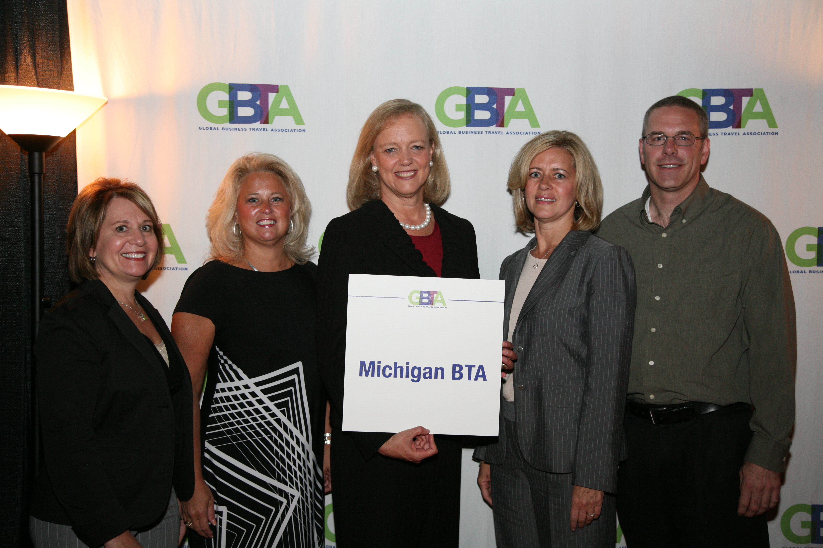
Make Michigan BTA A 2012 PARTNER

Slide 24
Next Steps…

