Slide 1
Welcome to the 2024 February Meeting!
Leap into success: Shaping the Trajectory of Travel in 2024
February 29, 2024

Slide 2


Thank you to our host!!

Slide 3

8:00am – 9:45am: Direct Benchmarking (Buyers Only)
Sponsored by Hubli
9:15 – 10:00am: Registration, Networking & Sponsor Expo
10:00am: Welcome & Introductions
10:15am: Sponsor Presentation - AmTrav
10:25am: 2024 Charity Reveal
10:35am: State of the Industry
Mark Cuschieri
11:35am: Break
11:45am: GBTAMI Business Meeting
GBTAMI BOD & Committee Chairs
12:15pm: Lunch, Networking & Sponsor Expo
1:30pm: Sponsor Presentation – Fiesta Americana
1:45pm: GLP Presentation: Flip the Script on your OBT RFP
Ed Phillips & Anna Price
2:45pm: Ask Anything!
Mark Cuschieri
3:45pm: Final Announcements & Drawing

Slide 4


Thank you to our meeting sponsor!

Slide 5
2024 CHARITY REVEAL!!

Slide 6

2024 Charity Introduction….
They provide military service members with an opportunity for rest and reflection as the deploy into harms way or return home from deployment.
The 4 Freedom Center locations in Michigan include:
Detroit Metro Airport (both terminals), and at the Military Entrance Processing Stations (MEPS) in both Lansing and Troy..
On Dec. 31, 2023, they reached 912,467 guests served. Going for 1 million!!!

Slide 7


Reflections and Projections for Global Business Travel
And What’s Next at GBTA
GBTA Michigan Chapter Meeting
February 29, 2024

Slide 8
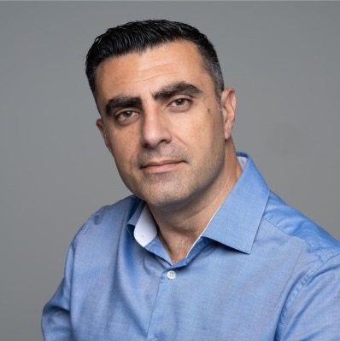



Mark Cuschieri
President, Board of Directors
GBTA
mcuschieri@gbta.org
Notes:
It is truly lovely to be here with you all today – thanks so much to the Amy, Justin and the entire Michigan Board for inviting me!
It’s truly an honor to serve all of you as president of GBTA.
The first non-American ever elected as an officer of this 55-year-old association – first as vice president, then as president.
I started my two-year term as president last August at the end of our Dallas convention. And I’ll say again, I’m very honored to serve our global membership in this capacity.

Slide 9


GBTA: Many Voices. One Purpose.
GBTA is the platform for all sides to come together to tackle the changes in business travel, bringing many perspectives together under one roof.
Community
Our members and GBTA advocate for the
Strengthening the bonds that hold the business travel community together
$1.4
Trillion
Global Business and Meetings Industry
Learning
The forum for members to learn about what matters most to them
Advocacy
Representing our members and advocating for our common interests
Source: 2023 GBTA Business Travel Index™ Outlook Report
Notes:
Now, how many of you are All Access members of GBTA? If you’ve been a member for a while – you know, like I do, that GBTA has been going through a lot of changes recently. It’s one of the reasons I’ve chosen to get involve / stay involved. Our association is evolving and changing for the better.
One of the biggest, visible changes we made was our new branding 18 months ago.
Through that process of self-evaluation, we recognized both our strengths and acknowledged our weaknesses. We came through that process with the realization that, at GBTA, our mission is to bring the many voices of our industry together with the one purpose of shaping the future of business travel – a 1.4 Trillion-Dollar industry.
We do this by delivering against our 3 platform pillars - community, learning and advocacy

Slide 10

Today’s Agenda
Current State
Global Business Travel Data and Insights
A Look Ahead
Latest Industry Outlook for 2024
Connect
What’s New and Noteworthy at GBTA
Notes:
So, aligned with those pillars and principles, today it is my pleasure to share some of the long-term forecasts for our global industry as well as for the U.S.
Additionally, I’ll be sharing some industry sentiments from our latest GBTA polls on timely topics for business travel professionals.
And I’ll also be revealing the outlook and focus areas for GBTA as well as news on upcoming events and initiatives you won’t want to miss.

Slide 11

The Current State of Global Business Travel
Notes:
First, let’s dive into what the data, trends, and recent sentiments have to tell us about the state of our industry.

Slide 12
A New Landscape for Business Travel
Dynamic changes and workplace transformation are influencing the world of business travel:
  The evolving way people work (where and when)
  Advances in technology and automation
  Increased focus on sustainability
  Fragmentation vs. retailing
  Traveller experience
All the while, meeting face to face remains unmatched.
Sustainably managed
business travel is a
force for good.
It drives progress for:
Businesses
Governments
Economies
People
Notes:
Now, plenty of things continue to change within the global business travel industry:
- the evolving way people work (from where and when)
- advances in tech and automation
- an increased focus on sustainability
- fragmentation likely getting worse within managed travel distribution ecosystems before they get better,
And
- a focus on the overall traveler experience.
But what remains consistent is that sustainably managed business travel is a driving force for good … for business, government, economies and people.

Slide 13

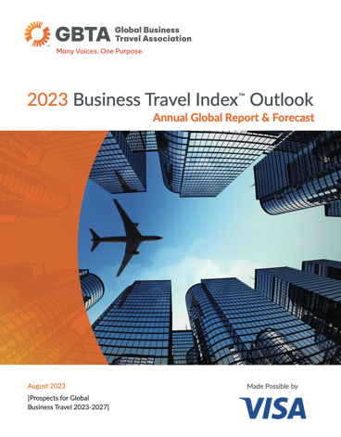


GBTA Business Travel Index™ Outlook
Annual exhaustive study of business travel spending and growth covering 72 countries and 44 industries
15th edition outlines the top-level forecast for global business travel spending 2023-2027
Survey and analysis of 4,700 business travelers across five global regions on spending and preferences
GBTA members can exclusively access the full 2023
BTI Report in the GBTA Hub.
CWT/GBTA 2024 Pricing Forecast
GBTA Business Travel Outlook industry sentiment polls
Sponsored and Partner Research Reports
Notes:
So, what does GBTA’s research tell us about the state of our industry beyond these trends?
Let’s review the most recent GBTA annual Business Travel Index, or BTI, (from August 2023), along with other key insights from the most recent Pricing Forecast, GBTA sentiment polls and other sponsored thought leadership reports.
Access to all of GBTA’s full research reports is a benefit for GBTA members, available on the GBTA Hub.

Slide 14
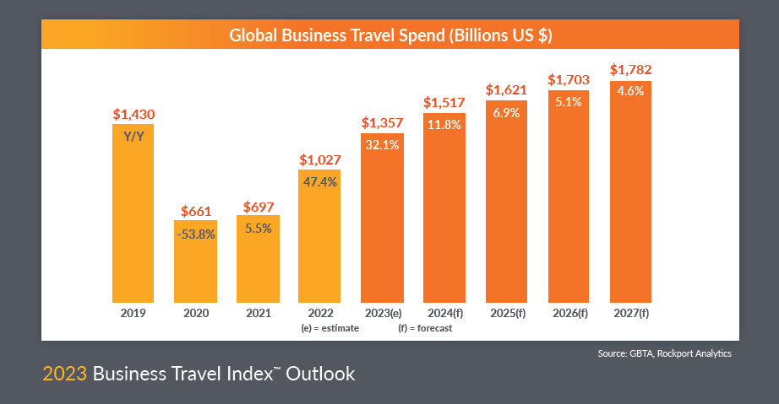
Notes:
According to last August’s BTI forecast, global business travel spending was expected to get close to a full recovery to pre-pandemic level of $1.4 Trillion in 2023.
More favorable economic conditions in 2022 and 2023 lifted the baseline of expectations for recovery.
Spending on global business surged 47% in 2022, finishing the year at $1.03 trillion.
Gains were fueled by pent-up demand from the Covid downturn in 2020 and 2021 — as well as by inflation driving up prices.
Overall, the global economy performed better than expected – even with that inflation.
So -- more favorable economic conditions in 2022 and 2023 lifted the baseline of our expectations moving forward.
Just to stress, this is spend, not volume.
Some of you might be questioning why are we comparing against pre-pandemic. This is purely from a research perspective, there are many companies that have zero desire to go back to pre-pandemic volumes for sure, and many organizations are certainly significantly below those levels. We’ll pick that up when we share some sentiment analysis

Slide 15
Notes:
Thus, this year – 2024 -- GBTA expects that we will not only be back at pre-COVID global spending levels, but even exceed them – reaching $1.5T.
Obviously, there are many factors that can affect actual outcomes but currently, the coming years beyond 2024 look set for future spending gains as well.

Slide 16
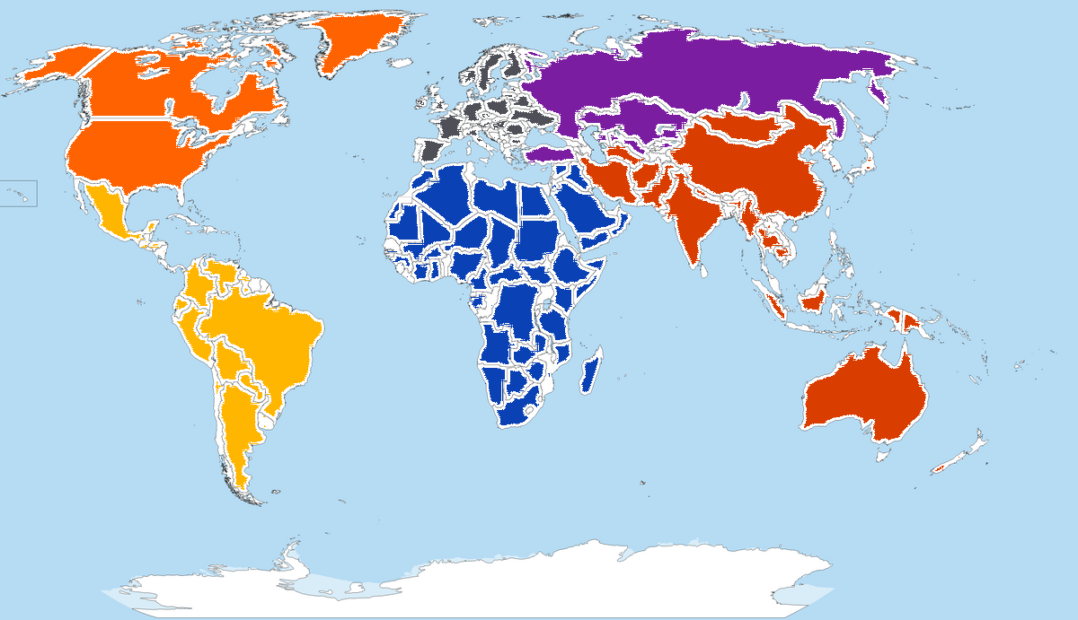
2023 Business Travel Spend by Region (estimated % of global total)
Western Europe
$314 billion
(23%)
Emerging Europe
$38.4 billion
(3%)
North America
$360.1 billion
(27%)
Latin America
$48.4 billion
(4%)
Middle East & Africa
$360.1 billion
(23%)
Asia Pacific
$567 billion
(42%)
Notes:
When we zoom down from a global view to a regional view, we can see the mix across regions in terms of business travel spending. This is the current state of the regional spending split.
Currently APAC accounts for 42% of global spend on managed business travel. Last out of the gates, in terms of the heavily imposed COVID restrictions, we certainly have seen a resurgence
North America accounts for 27%, Europe at 26% and other regions making up the difference.

Slide 17
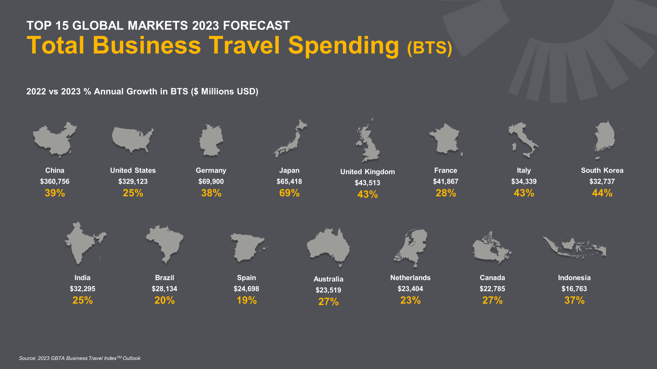















Estimated recovery by end of 2023
billions
2022 vs 2023 % Annual Growth in BTS ($ Millions USD)
billions of U.S. dollars (% of global business travel spend)
2023 Expected Business Travel Spend (% of global total)
China
$360,756
39%
United States
$329,123
25%
Germany
$69,900
38%
Japan
$65,418
69%
United Kingdom
$43,513
43%
France
$41,867
28%
Italy
$34,339
43%
South Korea
$32,737
44%
$360.8
$329.1
$69.9
$65.4
$43.5
$41.9
$34.3
$32.7
26.6%
24.3%
5.2%
4.8%
3.2%
3.1%
2.5%
2.4%
India
$32,295
25%
Brazil
$28,134
20%
Spain
$24,698
19%
Australia
$23,519
27%
Netherlands
$23,404
23%
Canada
$22,785
27%
Indonesia
$16,763
37%
$32.3
$28.1
$24.7
$23.5
$23.4
$22.8
$16.8
2.4%
2.4%
1.8%
1.7%
1.7%
1.7%
1.2%
Source: 2023 GBTA Business Travel IndexTM Outlook
17
Notes:
Lets drill down a bit further.
Interestingly, In 2022, China dropped back to the number 2 spot and the US was number 1. But with borders opening and the APAC region getting back to business into 2023, GBTA had forecast that China would be back to the top spot – from analysis back in June and July when our economist was evaluating the forecast.
We also saw some new entrants in the top 15: The Netherlands and Indonesia (on this list for the first time)
And moving up in their ranking from previous year: Japan, UK, Italy, South Korea and Australia

Slide 18





2024 Global Business Travel Forecast
Global Business Travel & Events Price Changes
(Year-Over-Year, $USD)
Airfares
Hotel Rooms
Car Rental
Meetings &
Events
AVERAGE TICKET PRICE
2024 forecast
$780
+1.8%
2023 forecast
$766 +2.3%
AVERAGE DAILY RATE
2024 forecast
$174
+3.6%
2023 forecast
$168 +4.3%
DAILY RENTAL RATE
2024 forecast
$49
+2.1%
2023 forecast
$48 +6.7%
AVERAGE ATTENDEE COST PER DAY
2024 forecast
$174
+3.0%
2023 forecast
$169 +5.6%
Source: CWT/GBTA 2024 Annual Global Business Travel Pricing Forecast
Notes:
Spend is, of course, affected by pricing. And GBTA explores that annually – here with the CWT GBTA Global Business Travel Pricing Forecast.
The report analyzes pricing predictors and other factors to help business travel managers plan their annual programs and policies.
The good news is, ongoing economic stabilization and the easing of supply-side constraints, we expect price increases to subdue through 2024. We expect global business travel and event costs to climb a bit higher this year, but, at a moderate pace than seen in 2022 and 2023 – across all categories shown here.

Slide 19
The State of Business Travel in the U.S.
Notes:
So, let’s take a look at similar data specifically for the US to see how it stacks up

Slide 20
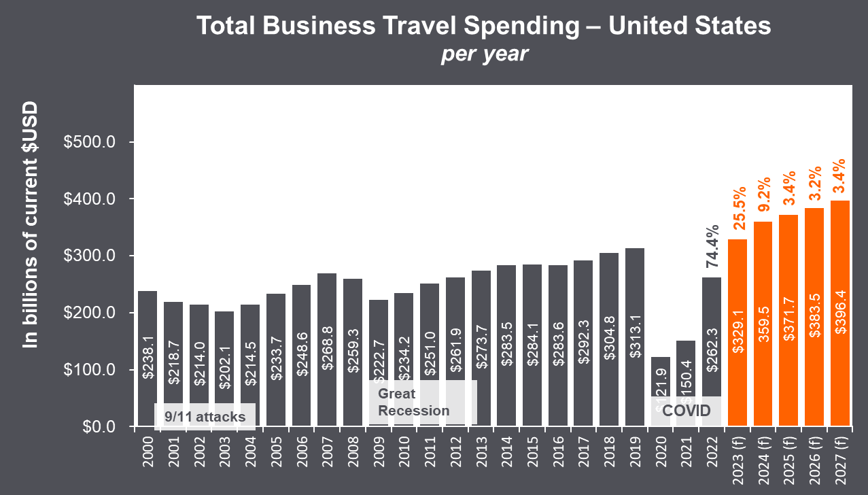

U.S. Business Travel Spend Expected to Surpass Pre-COVID Levels in 2023
Last year U.S. business travel spend was expected to grow another 25.5% and start to level off at 9.2% in 2024.
Source: 2023 GBTA Business Travel Index™ Outlook
Notes:
Business travel spend in the U.S. fell off at the height of the pandemic, declining 61% in 2020, which actually exceeded the global decline of 54%. However, business travel spend grew 74% in 2022 in the U.S.
In 2023, U.S. business travel spend was expected to grow another 26% and start to level off at 9% in 2024, then getting back to a “normal” growth clip of 3-3.5% in the years following.

Slide 21
U.S.: How Business Travel Spend Supports Sales
U.S. view of the estimated amount of sales activity supported for every dollar spent on business travel
2019
2022
2023
$1 spent on business travel for every
$120
of sales
$1 spent on business travel for every
$178
of sales
$1 spent on business travel for every
$145
of sales
Notes:
And business travel plays a key role in commerce, as we all know. GBTA finds it interesting to compare how much sales activity is supported by a dollar spent on business travel.
And you can see that it’s been a bit of a roller coaster… going from $1 spent on travel in 2019 supporting $120 in sales… to that same $1 supporting $178 in sales in 2022 – and getting closer to “normal” in 2023 with a dollar supporting $145 in sales.
GBTA will continue to watch these trends to add some budgeting strength to those of you who need to provide your CFOs with supporting evidence for benchmarking travel spend against other companies in the future.

Slide 22


From the source:
Today’s Business Traveler in the U.S.
TRAVEL WITH PURPOSE. 96% said they are traveling the same or more than 2019, and 84% said business travel is worthwhile to achieve their business objectives.
TRAVEL FREQUENCY. 47% have taken 1 to 2 business trips in the past 12 months with 20% taking 6 or more trips.
AVERAGE TRIP PROFILE. U.S. travelers average 3.6 nights for a business trip and report spending an average $1,241 per trip.
REASONS FOR TRAVEL. Convention or conference (19%), seminar/ training (18%), and sales/account/partner meetings (16%) are main reasons for travel.
HOW THEY BLEND. 45% have extended a work trip for leisure, while 72% report blending travel more frequently than they did in 2019.
Source: 2023 GBTA Business Travel Index™ Outlook
Notes:
The state of the industry wouldn’t be complete without considering business travelers themselves.
The BTI Report also includes insights from business travelers – this year we surveyed nearly 5,000 across 22 countries in 4 major regions. (Keep in mind that the respondents are mostly not road warriors, and travel mostly short-haul distances once or twice a year.
For US business travelers:
84% say business travel continues to be important in achieving their business objectives.
They are averaging 3.6 nights per business trip and estimate their work-related spend at a little over $1,200 per person per trip - this is longer and pricier vs. global averages (3.5 nights and $1018 per trip global averages
What gets the American business traveler out on the road for work? Primarily conferences (#1), training (#2) and sales meetings (#3).
In terms of behaviors, we learned that blended travel is still a thing according to these business travelers. 72% say they more frequently blend business and personal travel than they did in 2019
And 45% have added additional leisure days to their business trips
From the global results – it’s interesting for all of you hoteliers to note, 79% prefer to stay at the same property where they’ve begun their work trip.

Slide 23
The Industry’s Outlook
for 2024
Insights From the Latest GBTA Polls
Notes:
Now, let’s fast-forward 6 months from the BTI to get the most current sentiment from travel buyers and suppliers on their outlook for 2024 and other topics.

Slide 24
Despite Economic Concerns, Most Travel Programs Do Not Plan to Limit Business Travel
“Looking ahead to 2024 in terms of economic considerations, which of the following best describes your likely approach?”
Travel managers/procurement professionals
14%
32%
25%
As recession fears ease, companies continue to remain cautious about business travel.
25%
Implementing a plan to limit
business travel
Considering but no decision to limit business travel
Wait-and-see approach but are not seriously considering limiting business travel
Unlikely to limit
business travel
Source: GBTA Business Travel Outlook Poll, October 2023
Notes:
Back in October, considering 2024 budget expectations, one-quarter of buyers said they were unlikely to limit and
one-third of buyers would take a wait-and-see approach but were not seriously considering limiting business travel because of economic concerns.

Slide 25
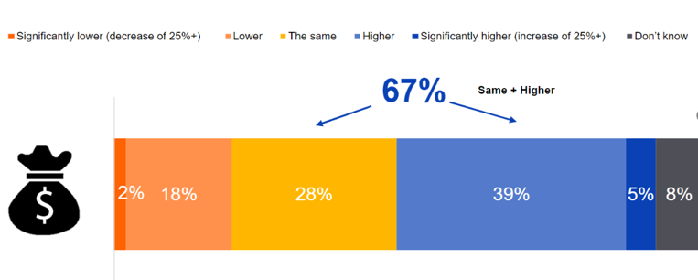
Most Buyers Expect Travel Budgets to Increase − or Remain the Same − for 2024
“How does your company’s 2024 travel budget compare
(or is likely to compare) to the 2023 travel budget?”
Travel managers/procurement professionals
Travel buyers largely expect their travel budgets to increase or stay the same this year.
One in five expect their budget to decrease.
2%
Source: GBTA Business Travel Outlook Poll, October 2023
Notes:
Also from the October Pool,
67% of Buyers expected their company’s travel budget would increase (39%) or remain the same (28%) next year, with some expecting a significant increase (5%).
(One in five (20%) expected their company’s travel budget would decrease.)

Slide 26

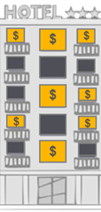



The Travel Buyer’s Perspective
“How do you expect your company’s business travel spending
will change in 2024 compared to 2023?”
travel buyers only
Travel buyers expect to spend more on business travel.
Two-thirds of buyers expect their company’s business travel spend will increase this year.
2%
Much lower than last year (20%+ decline) vs. 2023
10%
Somewhat lower than last year (1%-20% decline) vs. 2023
21%
About the same as it was in 2023
55%
Somewhat higher than last year (1%-20%) increase vs. 2023
11%
Much higher than last year (20%+) increase vs. 2023
**3% say “don’t know”
66%
expect their company’s 2024 business travel spend will be higher
Source: GBTA Business Travel Outlook Poll, January 2024
Notes:
And now we get to current date sentiment – and budgets that were set with more optimism than expected.
87% expect to spend as much or more on business travel than in 2023
Two-thirds of travel buyers (67%) expect their company’s business travel spend will increase this year. However, these increases could be modest.
A larger number expect their spend will will be somewhat higher (55%) than much higher (11%).
Far fewer expect a decrease in travel budgets than indicated as recently as October.
This is likely a combination of price increases as well as economic conditions settling CFOs’ 2023 biggest concerns.

Slide 27





The Travel Buyer’s Perspective
“Do you expect your company will engage in more or less
business travel than it did in 2023?”
travel buyers only
Almost three in five travel buyers expect their company will take more business trips this year.
One-quarter expect the same number and one in 10 expect fewer trips.
1%
A lot fewer business trips (20%+ fewer) vs. 2023
10%
Fewer business trips (1%-20% fewer) vs. 2023
28%
About the same amount of business trips
50%
More business trips (1%-20%) additional business trips vs. 2023)
9%
A lot more business trips (20%+) additional business trips vs. 2023
59%
expect their company will take more business trips this year
**3% say “not sure”
Source: GBTA Business Travel Outlook Poll, January 2024
Notes:
That was spend. It’s a different picture in terms of volume
On a global basis while the same 87% expect their companies to have as many or more trips than in 2023, fewer expect an increase in volume vs. spend – 59% vs. the prior slide’s 66%.
More expect volume to be about the same vs. spend
Since sustainable solutions are still in development, this can serve to give the industry some lag time to get moving on innovations which can help to keep our industry viable and make it net-zero.
Making travel more sustainable is a critical task for us all

Slide 28






Sales and Account Management Trips Remain the Largest Category
The Travel Buyer’s Perspective
“Approximately what percentage of travel spend will be allocated to each of the following types of trips in 2024?”
Averages calculated from open-end responses
Sales and account management trips still represent the largest category – and buyers expect this will continue.
32%
12%
Sales/account management meetings with current or prospective customers
Service trips (such as repairs, training or equipment installation) with current customers
Other
20%
8%
6%
Internal company meetings with colleagues
Employee training or development
15%
7%
External Conferences, trade shows, or industry events
Supplier meetings
Source: GBTA Business Travel Outlook Poll, January 2024
Notes:
So – what are the current top reasons for corporate travelers to hit the road?
According to the travel buyers who manage this travel and spend, Sales and account management trips still represent the largest category – and buyers expect this will continue in the future.
On average, buyers estimate these trips will account for 32% of their company’s business trips this year. Internal meetings – which hypothetically was going away – are still a powerful reason to travel – here garnering 2nd place or 20% of all business trips.
Maybe due to the shift and rise of remote workplace, getting teams together

Slide 29


Significant Issues the Industry Expects Will Impact Business Travel in 2024
travel buyers
travel suppliers/TMCs
Rising costs of travel
Overall economic concerns
Corporate budgets not keeping pace with needs
Financial concerns remain top of mind for business travel professionals in 2024.
Buyers are more likely to have concerns about rising costs and travel disruptions, while suppliers are more likely to pick technology advancements and remote work and hybrid office rules.
Travel disruptions
Geo-political concerns
Climate impact/sustainability concerns
Technology advancements / artificial intelligence
Concerns of frequent travelers (such as entitlements, upgrades, and well being)
Remote work and hybrid office rules
Meeting & event space availability and ease of booking
Workforce hiring/retention
Traveler confidence/willingness to travel
Passport/Visa processing times and/or delays
Pandemic concerns
Source: GBTA Business Travel Outlook Poll, January 2024
% of the top 3 options most selected out of 14 provided
Notes:
Despite an improving economic outlook, falling inflation, and receding fears about a possible recession, financial concerns remain top of mind for business travel professionals in 2024.
Asked to pick the three most significant issues facing the industry this year, buyers and suppliers commonly pick rising costs of travel and overall economic or budgeting concerns.
Buyers are more likely than suppliers to pick rising costs and travel disruptions. Suppliers are more likely to pick technology advancements and remote work and hybrid office rules.

Slide 30
What’s New and Noteworthy at GBTA
Notes:
So – back now to the association and GBTA – what’s new that you should know about?

Slide 31

For the industry:
  Define for the industry – and those outside – the value and necessity of proper “travel for work”
  Advocate for cross-industry action and progress on sustainability for People & Planet
  Create momentum to ensure business travel’s strategic seat around the corporate ”table”
  Foster innovation and drive needed change in the industry through our members
  Bring new talent into our industry – and educate them on managed business travel practices
For the association:
  Expand member and sponsor value – growing our base of members/types and increasing engagement
  Advance globalization focus, both intra-region and cross-region
  Continue to invest in our team and resources to deliver on association and industry objectives
2024-2026 GBTA Objectives
Notes:
The board and I have worked with Suzanne and her team on our overarching 3-year objectives
which reflect GBTA’s relevance within the industry, as well as, and importantly toward our membership, YOU
These objectives reflect our priorities – whether that’s in our advocacy, the learning we provide, or the events which we hold.
Travel is a force for good, but we need to do so sustainably and we need to continually advocate as such
Our People are our greatest asset. As our industry continues to evolve, the need for continuous learning becomes even more critical.
We need to shout about the great things this industry offers, to bring new talent into our industry

Slide 32
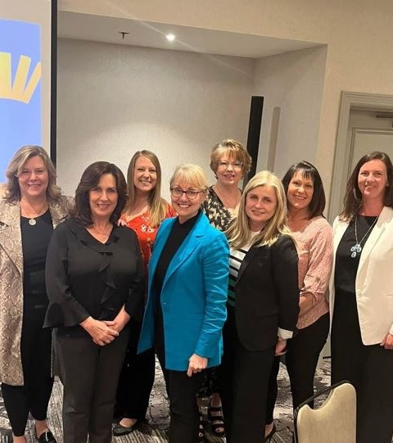
Collaboration and Connection with GBTA Chapters
A Local and Global Community
Bringing together and representing the many voices of our industry – now on a global level
Expanding the GBTA team and talent to 70 people across the globe
Meeting and connecting with ongoing and new GBTA Staff at a local level
Working together for mutual progress and outcomes for professionals and our industry
Notes:
Its our objective to connect, educate and inspire
In the US, our 37 chapters are a strong, grassroots community that help professionals stay connected on a local level.
In Europe, we operate organizations in France and Italy, and operate via partnerships with several national associations
so whether it’s with the British, German, Nordics, Dutch, or Spanish – we also work in Europe to gather the local sentiment and priorities for our Community, Learning and Advocacy initiatives.
GBTA also continues to build its talent and team – today there are about 70 people at GBTA working around the world – all fully remote since we gave up the office in Alexandria, VA, in 2022.
In partnership with you and your members, we look to serve national and international members with best practice learnings and great networking opportunities.

Slide 33
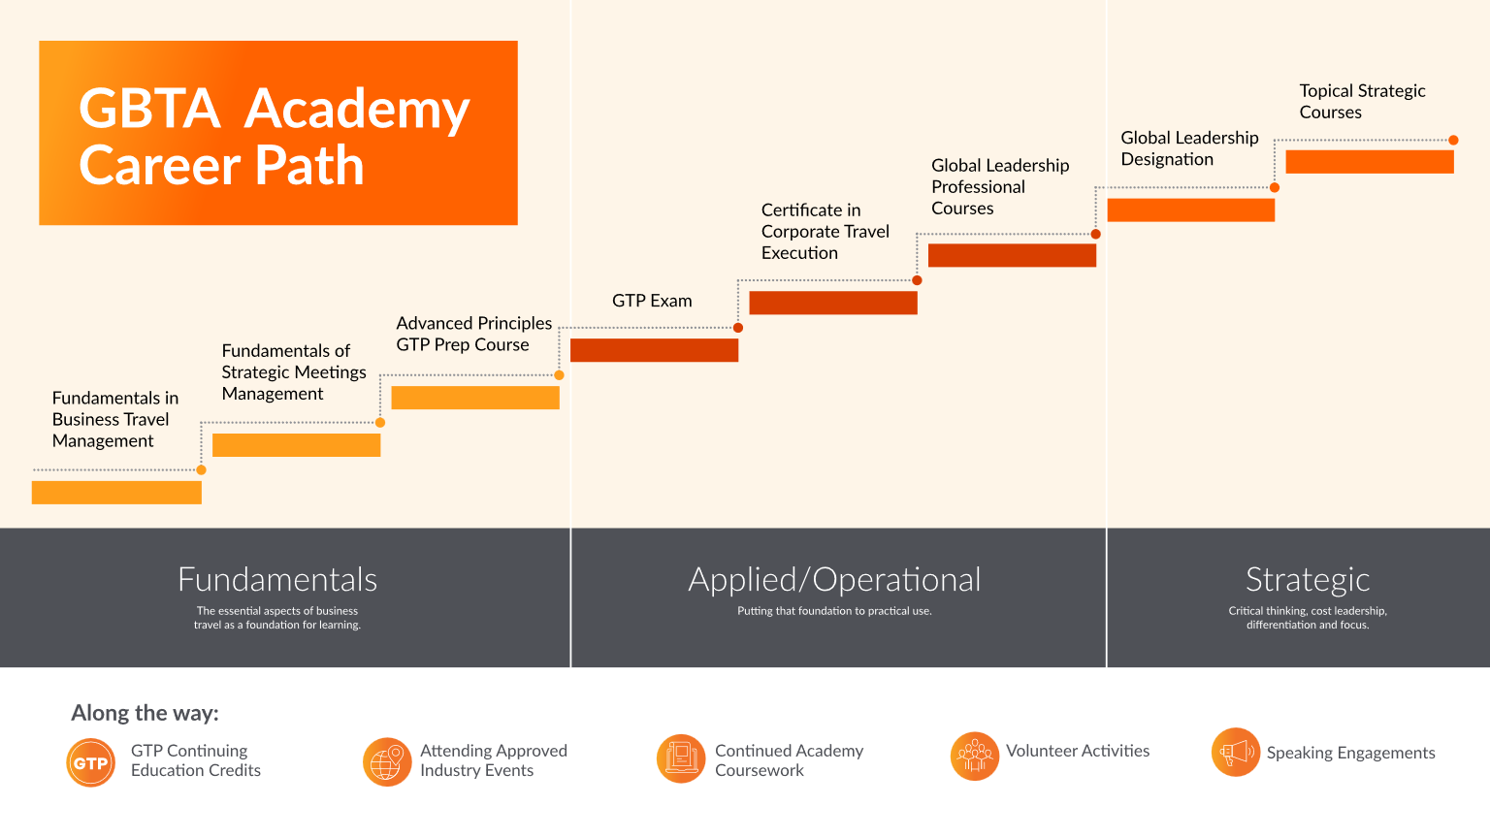
Advancing Professional Development and Career Opportunities
Notes:
As I mentioned already, our greatest asset in this industry is the people within it, YOU
Our Academy for more than a decade has provided advanced learning opportunities for our members… and I like to think of this stair-step image as one of the huge values we provide to our business travel industry and community.
We cannot under-estimate the importance of Industry Education:
Think about the pace at which the industry is evolving, whether you’re an industry veteran or new to the industry.
We’re in a period of continuous learning and I’m sure there’s something in here that can help you and your teams with their own professional development and growth.

Slide 34


GBTA Advocacy: Focus Areas
Travel Facilitation
Digitalization of Travel Documents
Biometrics
Preclearance
Sustainable Travel
SAF production
Emissions accounting
Travel Infrastructure
Air, rail, bridges and highways
Multimodal digital platforms
Notes:
As you saw in the beginning, Advocacy is one of our 3 main pillars… and we’re actively advocating for this industry in Washington, Brussels, Ottawa and soon London.
Our core focus areas are Travel Facilitation, Sustainable Travel, and Travel Infrastructure
There are times when it is absolutely necessary to seek government intervention, support for this industry. Sustainable Travel is a force for good

Slide 35



The GBTA Foundation was relaunched in July 2022 to collectively galvanize the business travel community.
The mission is to drive positive impact for our People and Planet – bringing together buyers and suppliers to build skills, transfer knowledge, co-create joint solutions and advocate for meaningful industry action and investment.
Presentation Title Goes Here
35
Notes:
By raise of hands, how many of you are familiar with the GBTA Foundation?
GBTA Foundation is the charitable arm of GBTA, re-established in 2022 to galvanize the business travel community around topics related to People and Planet.

Slide 36
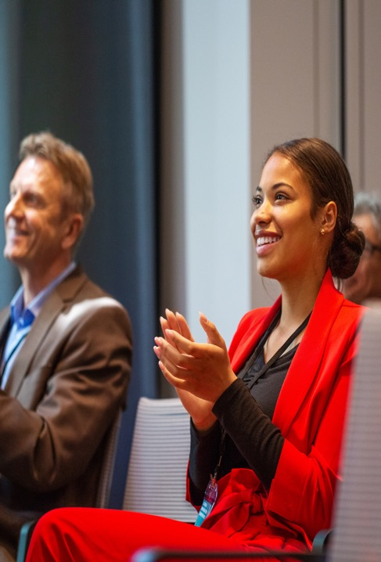

Find out more and how you can get involved at www.gbtafoundation.org
Presentation Title Goes Here
36
Notes:
On the People side, the Foundation advances careers and incubates programs to build a diverse, resilient workforce.
On the Planet side, we support the integration of sustainable practices across the business travel lifecycle.
You’ll likely recognize or are even involved in some of the core programs under the GBTA Foundation such as our amazing WINiT and Ladders and GBTA’s Sustainability and climate action initiatives.
Maybe you’ve downloaded our sustainability toolkit or read one of our reports delivered since spring of 2022.

Slide 37


Championing Climate Action in Travel
|
Building capacity to help travel professionals implement more sustainable practices
Driving industry collaboration and multi-stakeholder partnerships
Advocating for policies that accelerate the decarbonization
of business travel
Notes:
The GBTA Foundation and the Association have committed to champion climate action through education, research, and advocacy.
Individual companies can do great things, but working together and collaboratively across the industry, we can drive action and have a greater impact in creating a better and more sustainable future for people, the planet and global business travel.
This is an industry play and we must come together on our collective journey to net zero. Everyone is on their own journey, and that’s absolutely fine
As I say, what little we do today is more than what we did yesterday

Slide 38




|
Empowering Women in their Careers
Inspiring communities of mission-focused individuals
Enhancing skills via leadership development programs
Providing access to the industry’s top leaders
Notes:
GBTA's long standing WINiT program empowers women in their careers through community, learning and advocacy programs
The program offers access to resources, mentorship, and training programs to help women excel in their careers and overcome challenges they may face

Slide 39




|
Developing the Next Generation of Professionals
Team-based mentoring on industry challenges
Professional development sessions
Accelerating change through collaborative projects
Notes:
And finally,
the GBTA Ladders Program celebrates its 10th year this year – focusing on developing the next generation of professional through mentoring, project collaboration and professional development – all the while giving valuable peer to peer networking opportunities.

Slide 40
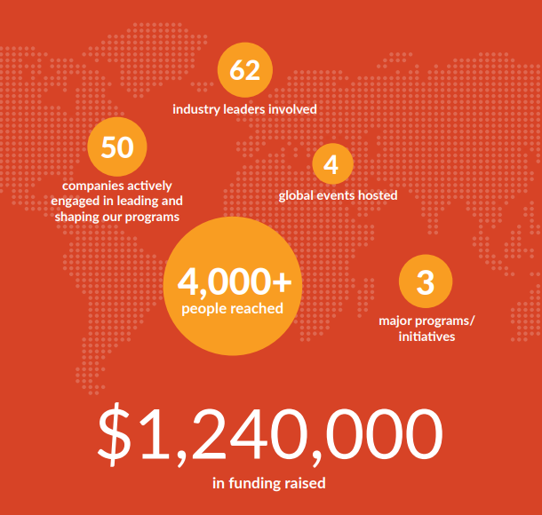

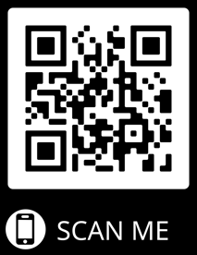
Download the 2022-2023 Progress Report
40
Notes:
it’s a program near and dear to my heart and I’m honored to serve on its board of directors these next two years. You can read more about the progress of the Foundation here –
We’ll publish our 2023-24 version of the progress report in the coming weeks – please keep an eye out for it as we strive to make a difference not just within managed travel, but also throughout the broader travel industry.

Slide 41
GBTA Board of Directors Elections
2024 Candidate Opportunities and Timeline
6 open seats
  2 Direct seats
  3 Allied seats
  1 Europe Regional Direct
2024 Timeline
  March 1: Nominations go live
  March 26: Nominations close
  May 10: Candidates are announced
  May 22: Meet the Candidates Virtual Town Hall
  May 24: Voting opens
  June 25: 5pm ET: Voting closes
  June 26: New Board members announced, GBTA Annual Business Meeting
Mark Your Calendars!
And make sure you’re an active GBTA member by May 14th. Only GBTA members can voting in the Board Elections as an exclusive benefit.
Notes:
I got involved in the GBTA board because I’m passionate about this industry and governance is an area I feel is incredibly important. Smart governance makes an organization stronger – enabling them to thrive for years to come.
During my tenure, its been about resetting the board, not just for the period of time that myself and my fellow directors are serving. We want to establish an association that’s fit for purpose, but will not be front and facing. Our priority is to be that sounding board, establishing strong governance, and supporting Suzanne and the amazing GBTA team in delivering against our strategy.
A very important part of GBTA’s governance are the volunteers who step forward to take leadership roles, including those serving on the GBTA Board of Directors.
For our 2024 Elections, there will be 6 open seats. And now is the time to start thinking about if you want to run – nominations can be submitted starting March 1st.
Voting for the GBTA Board is exclusive to GBTA and GBTA All Access members – so make sure you join or renew your GBTA membership by May 14th to be eligible to vote. Your vote is extremely important

Slide 42
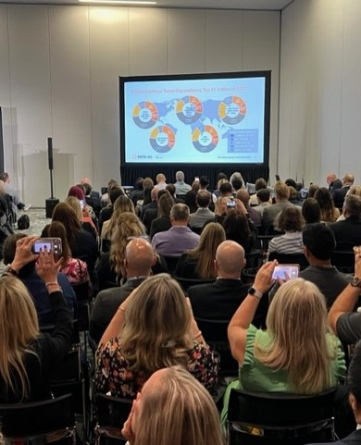

What’s New for GBTA Convention 2024
Starts Monday early afternoon, ends on Wednesday EOD, continuing with our 2 ½-day format
Weekend prior offers THREE in-person Academy course options
Monday kicks off with charity fitness activity, Buyer-only Roundtables, First Timers Orientation – and Media Day
Three daily Main Stages followed by Expo time plus Education Sessions Tuesday / Wednesday morning
Thursday invitation-only All Committee Meeting
Notes:
So, what’s new for Convention this year. In Atlanta, scheduled for July 22-24.
Every year we solicit feedback, we try to mix it up, try new things and all focused on making sure you get the most out convention
Here are just a few of the new features for 2024…
As I always say, if you can come away from any event with one new nugget of information and one new connection, that’s got to be a great outcome.
Stay tuned for more and follow our GBTA channels for more updates
I really look forward to seeing you in Atlanta in July

Slide 43
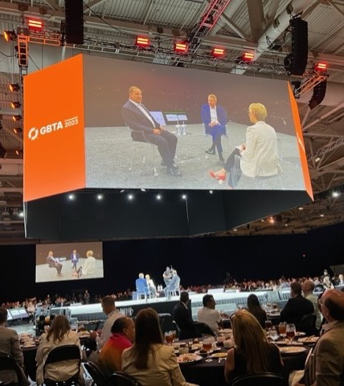
Connect with GBTA at
Upcoming Events
GBTA Canada Conference,
Toronto
US Legislative Summit, Washington, DC
April 3-4
May 14-15
July 22-24
April 22-24
June 10-12
GBTA LATAM Conference, Mexico City
GBTA APAC Conference, Singapore
GBTA Annual Convention, Atlanta, GA
Notes:
And as we talk about the value of connecting.
There's a lot in store and a lot of opportunity to connect in the coming year - we run nearly 60 in-person events a year, around the globe,
Here’s a look at the calendar of key events happening in the coming months in the America’s region and beyond.
I do hope you can join us for one or more of these!

Slide 44
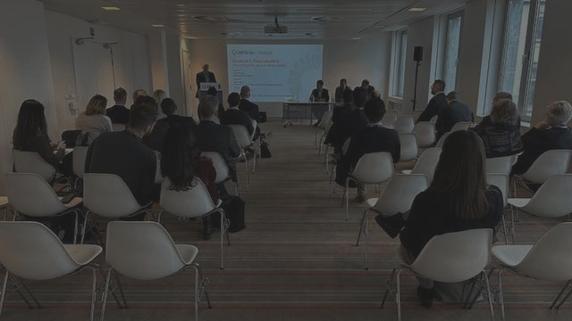

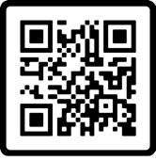

Thank you!
Engaging the many voices of global business travel to build our collective future
Join or Renew Your GBTA Membership
Notes:
It takes many voices to build this industry’s collective future.
It's only by listening to and bringing together the many voices – like yours here today – along with those of the GBTA community around the world, that we'll achieve our common purpose to build a strong collective future for global business travel.
And with that...again, I’m very excited and so appreciative to be here and look forward to connecting with you throughout the day….especially our Q&A session – Ask Anything! Scary!
Thank you!

Slide 45

Networking Break

Slide 46
Business Meeting

Slide 47
Charity Committee
Committee Chair: Gail Major
2023 Accomplishments….
GBTA Michigan members are the most supportive to our charities then I have personally ever seen.
Drawings at 2023 meetings: $1,130
Photo Proceeds: $210
Enterprise Holdings: $2,500
AMETEK: $5,000
Silent Auction: $9,135
$17,975
Our Commitment:
As a committee member we are committed to supporting our charity for the year by raising as much funds at our events. As well as soliciting donations from every source we can partner with.
As MBTA members, be prepared to hear from us for your support with donations for drawings, giveaways and as always, our phenomenal holiday auction.
Most importantly having fun!!

Slide 48
Charity Committee
Committee Chair: Gail Major
Meet our committee members……
Kim Burns, Lear Corporation
Jill Partaka, Dlux Suites
LaGenya Bateman, Robert Bosch
Michael Toles, Assure Travel
Laura Nickel, Residence Inn Ann Arbor North
Board Liaison, Justin Morris, Traxo
Our Commitment:
As a committee member we are committed to supporting our charity for the year by raising as much funds at our events. As well as soliciting donations from every source we can partner with.
As MBTA members, be prepared to hear from us for your support with donations for drawings, giveaways and as always, our phenomenal holiday auction.
Most importantly having fun!!
Anyone interested in joining our team, please reach out to Gail Major, 313.595.3960 or charities@gbtamichigan.org, we would love to have you.

Slide 49
Education Committee
Chair: Cheryl Keyes, Options Travel/Keller NA
Next Meeting Topic:
April: ChatGPT & AI
Committee Members
Cheryl Benjamin - GFS
Eugenia Fregoso – Posadas Hotels
Blaise Gener - Marriott
Michelle Harms – Amex-GBT
Heather Roden – Haworth
Yana Walker - BWH

Slide 50

Government

Slide 51
Meeting Committee
We are excited to announce the location of the April 18th event…
Nicole Poggione
Embassy Suites by Hilton Detroit Livonia Novi
Meredith Upward
Amy Marciano-Ratliff
NIQ
Karen McDaniels
Area Director of Sales
Aimbridge Hospitality
~ 𝟮𝟬𝟮4 𝗠𝗲𝗲𝘁𝗶𝗻𝗴 𝗗𝗮𝘁𝗲𝘀 ~
April 18: Bring You Boss/Approver Event
June 6: Michigan Capital Day
Summer Event: TBD
September 26: Annual Meeting & Trade Show
December 5: Holiday Event & Charity Auction

Slide 52
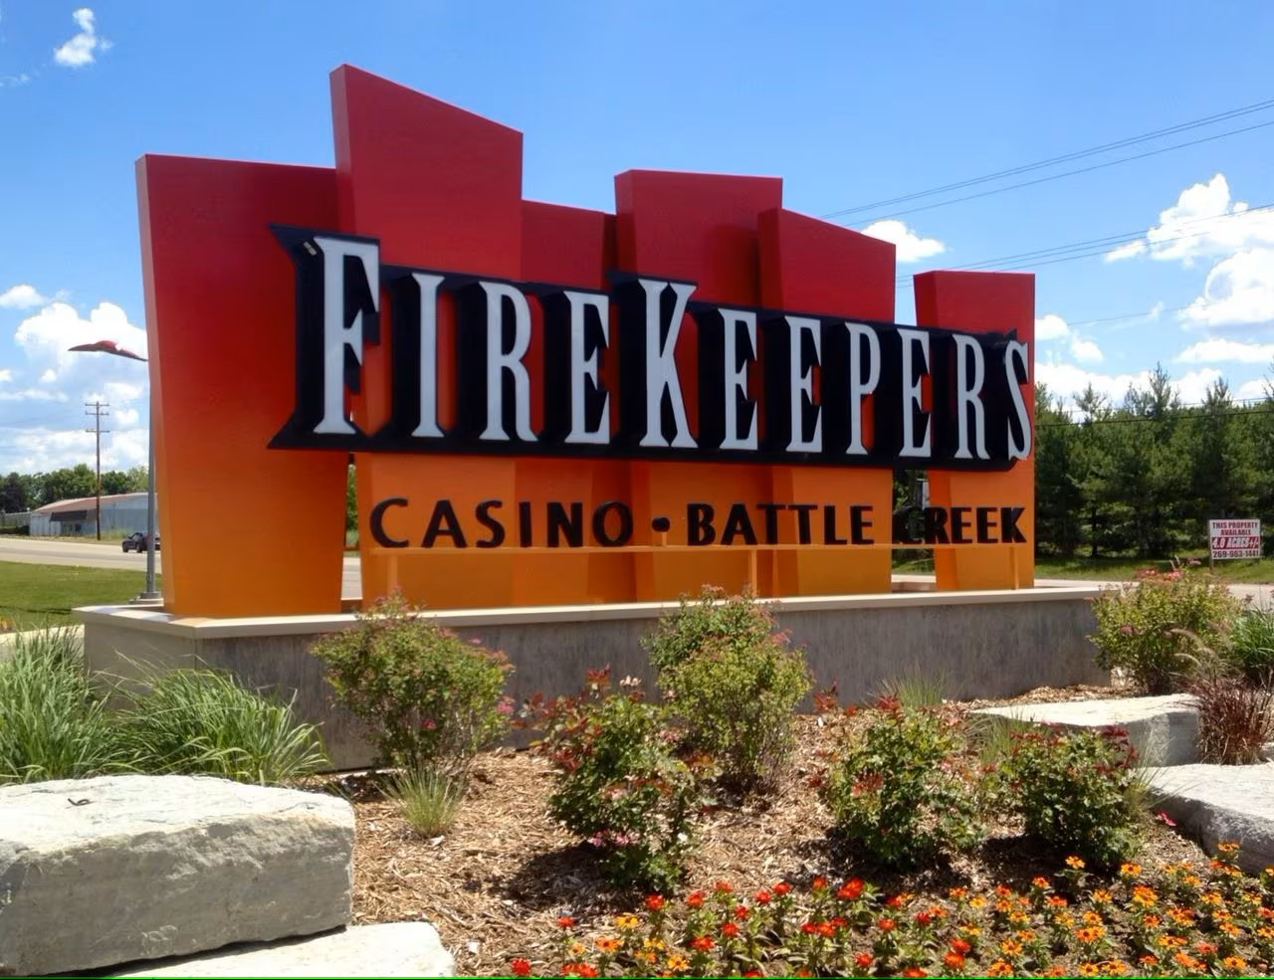

Save the Date
April 18th, 2024
Bring You Boss/Approver Event

Slide 53
Membership Committee
Chair: Megan Craig, Hotel Indigo Detroit Downtown
Welcome New Members!
Susan Altman- Amtrav
Rajka Andelic- GoRentals
Justin Bray- BAE Systems
Jason Curtis- BCD Travel
Basheer Elhubishl- Metro Black Sedans
Diane Ferich- Marriott Centerpoint
Pamela Glass- Adelman Travel
Laurie Grenzicki- Amex GBT
Michael Hook- FCM Travel
Samantha O’Mera- Amtrav
Saundrea Sanburn- Cummins
Carla Sunseri- FCM Travel
Stephanie Zdun- Meijer
Committee Members
Hiba Fashho,
Superior Hospitality
Michael Hook, FCM Travel
YOUR NAME HERE!

Slide 54
Sponsorship Update
Thank You 2024 Sponsors!!!
We are grateful for your continued support of the GBTA MI Chapter.
  Over $52,000 in annual sponsorships.
  Throughout the year there will be other sponsorship opportunities available, just contact a member of the Sponsorship committee.
Your Sponsorship dollars provide our Michigan Chapter with:
  Continued Education
  Member Scholarships
  Supplementing Cost of Meetings
Interested?
Contact a member of the Sponsorship Committee:
Shirley Randall
Ann Ammons
Michelle Wightman
Kerri Nelson

Slide 55
























Thank You 2024 Sponsors!
Diamond
Platinum
Gold
Silver
Bronze
Copper
Notes:
GO LIVE ON FACEBOOK!

Slide 56
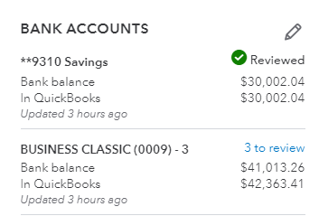
Treasury
Michigan Business Travel Association
Balance Sheet
As of February 23, 2024
 | Total
ASSETS
Current Assets
Bank Accounts
**9310 Savings | $30,002
BUSINESS CLASSIC (0009) - 3 | $41,013
Total Current Assets | $71,015
TOTAL ASSETS | $71,015

Slide 57
Michigan Business Travel Association
Profit and Loss
January 1 - February 23, 2024
 | Total
Income
Meeting Fees | $ 818.39
Membership Dues | $ 6,763.24
Sponsorships | $ 29,132.57
Total Income | $ 36,714.20
Expenses
Board Expense (Leadership Summit) | $ 3,308.55
GBTA StarChapter Fees & QB | $ 29.90
Insurance | $ 460.00
Meeting Expenses | $ 554.23
Scholarships | $ 2,785.85
Total Expenses | $ 7,138.53
Net Operating Income | $ 29,575.67
Other Income (Chapter Challenge & Interest) | $ 208.27
Total Other Income | $ 208.27
Net Income | $ 29,783.94
Friday, February 23, 2024 01:42:13 PM GMT-8 - Cash Basis
Profit & Loss |  | This year to date
Net profit for 2024 to date
$29,783.94
⬆ Up 95% from this time last year

Slide 58
Lunch, Networking & Sponsorship Expo!

Slide 59
Thank you to our meeting sponsor!

Slide 60



Slide 61

Posadas has a history of solid growth since the opening of its first hotel in 1970.
Posadas is the leading hotel operator in Mexico that owns, leases, franchises and manages more than 187 hotels and 31,000 rooms in Mexico and the Caribbean, under its 9 brands, achieving efficient centralized management and high-level economy of scale.

Slide 62



SENSORIAL LIFESTYLE HOTELS
This exclusive hotel concept opens the doors to all your senses. At Live Aqua, your desires determine the type of stay you will have.
The refined details will win you over and create memorable moments along the way.
Live Aqua Monterrey Valle
Live Aqua México City
Live Aqua San Miguel Allende
Live Aqua Cancun
Live Aqua Punta Cana

Slide 63
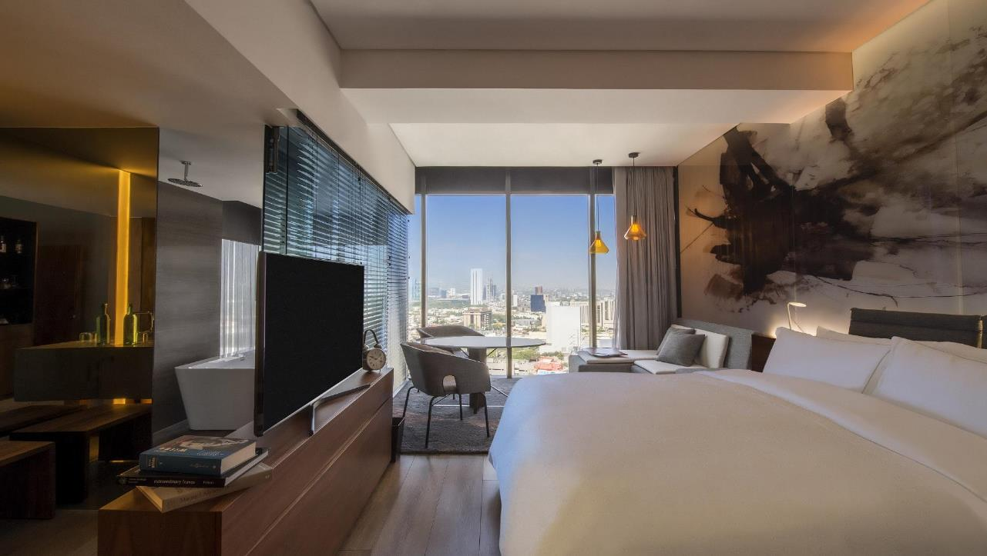


Slide 64



Slide 65
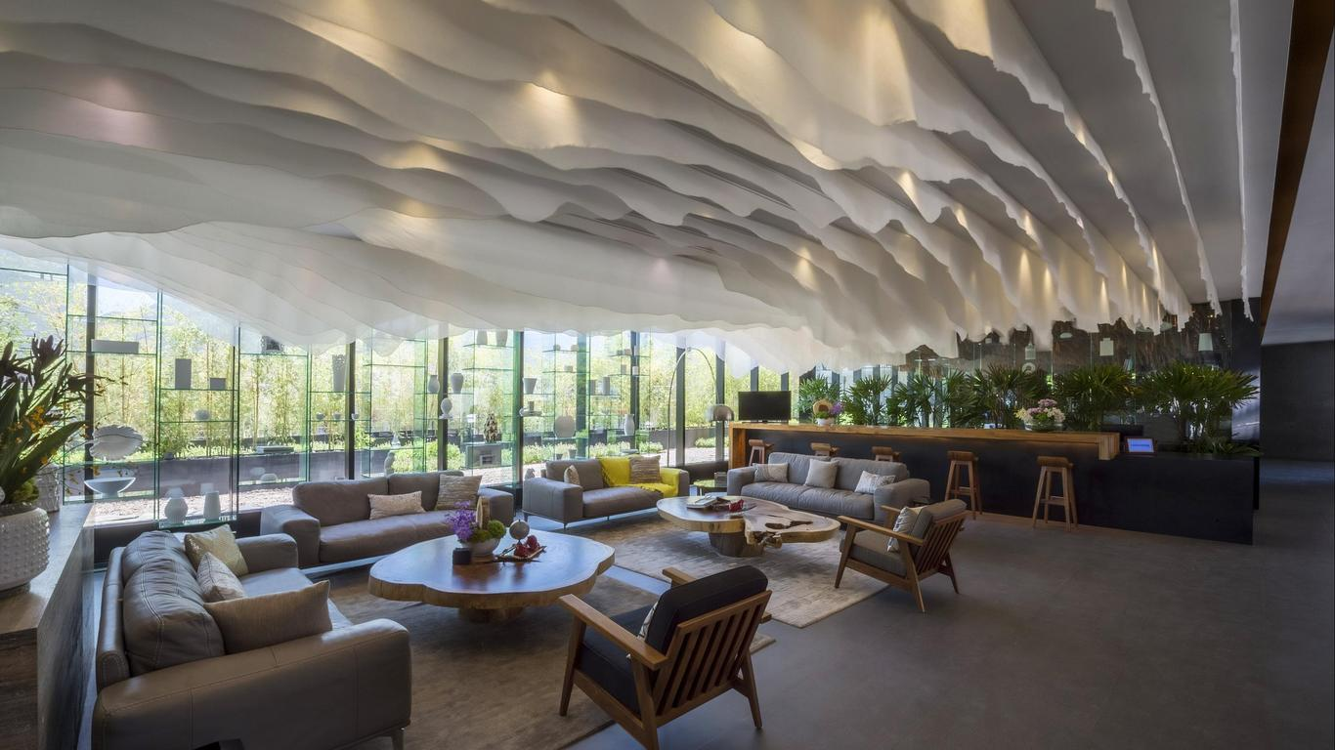


Designed for travelers seeking true luxury in an exclusive atmosphere.
Noted for special touches and unique amenities, the hotels focus on delivering an excellent, high-quality personal service and unrivaled hospitality. Its grand and luxurious facilities are the jewels in the crown of Fiesta Americana's.

Slide 66

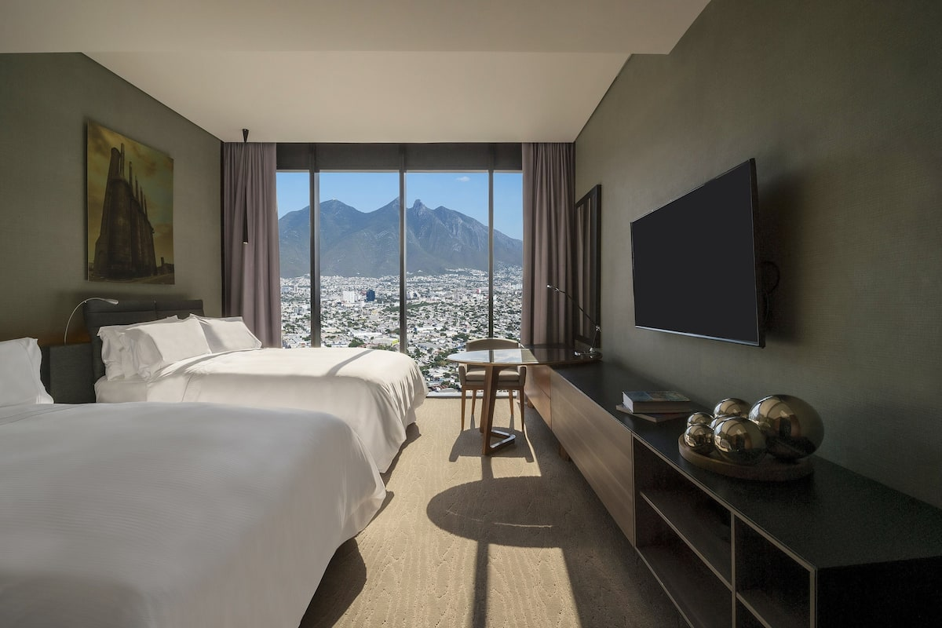


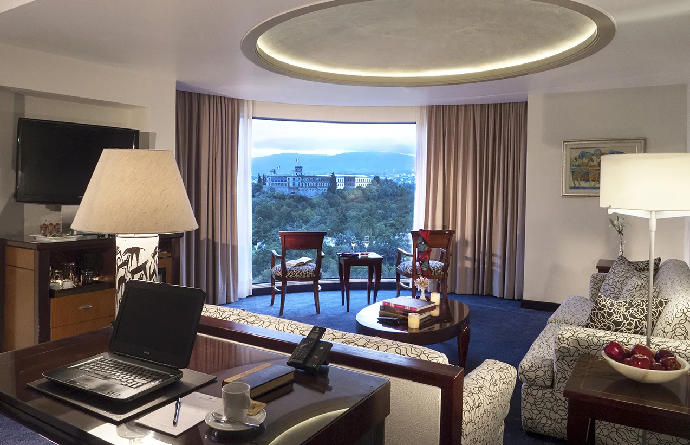
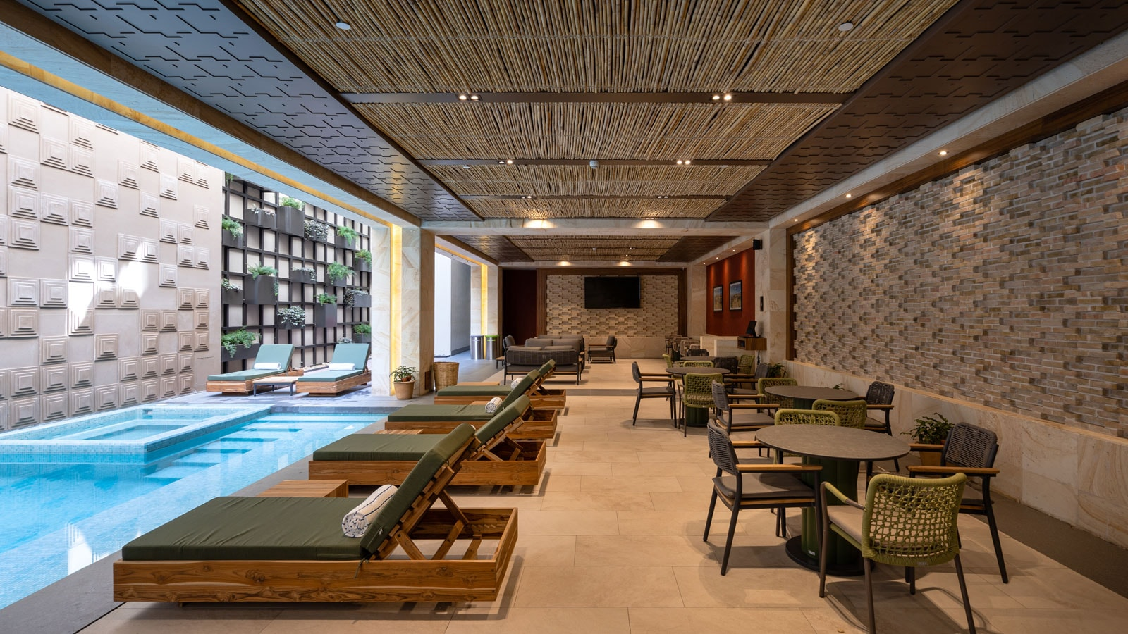



Grand Fiesta Americana Chapultepec
Grand Fiesta Americana Coral Beach Cancun Resort
Grand Fiesta Americana Guadalajara
Grand Fiesta Americana Los Cabos All Inclusive
Grand Fiesta Americana Monterrey Valle
Grand Fiesta Americana Oaxaca
Grand Fiesta Americana Puebla Angelopolis
Grand Fiesta Americana Queretaro
Grand Fiesta Americana Sumiya Cuernavaca
Grand Fiesta Americana Veracruz
Grand Fiesta Americana Guadalajara
Grand Fiesta Americana Monterrey Valle
Grand Fiesta Americana Oaxaca
Grand Fiesta Americana Chapultepec

Slide 67

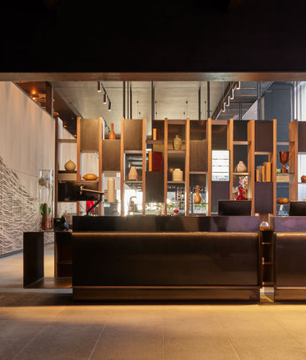

The five-star hotels of Fiesta Americana blend Mexican hospitality and architecture with the service, charm and quality of the world's finest hotels. Warm, casual and friendly, the hotel and its staff will ensure your stays are perfect at these beautiful venues in Mexico's famous beaches and resort towns.
Fiesta Americana Aguascalientes * Fiesta Americana Guadalajara * Fiesta Americana Hermosillo *Fiesta Americana Merida * Fiesta Americana Mexico Satelite * Fiesta Americana Monterrey Pabellon M * Fiesta Americana Puerto Vallarta
Fiesta Americana Reforma * Fiesta Americana San Luis Potosi
Fiesta Americana Toreo Mexico * Fiesta Americana Viaducto Aeropuerto * Fiesta Americana Villas Acapulco

Slide 68
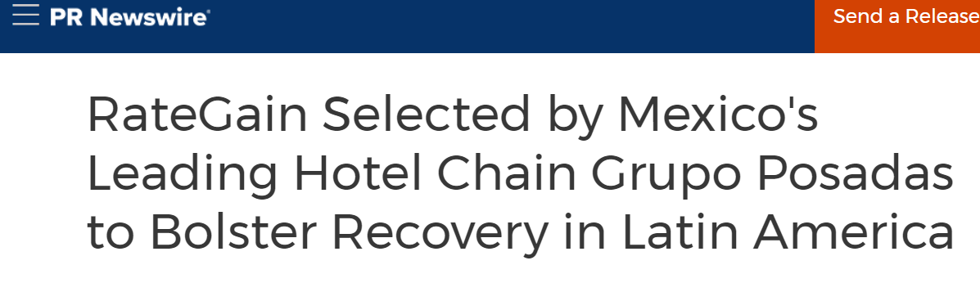
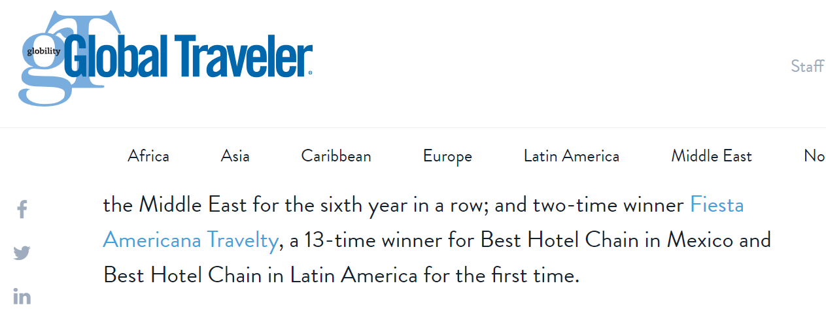


Slide 69

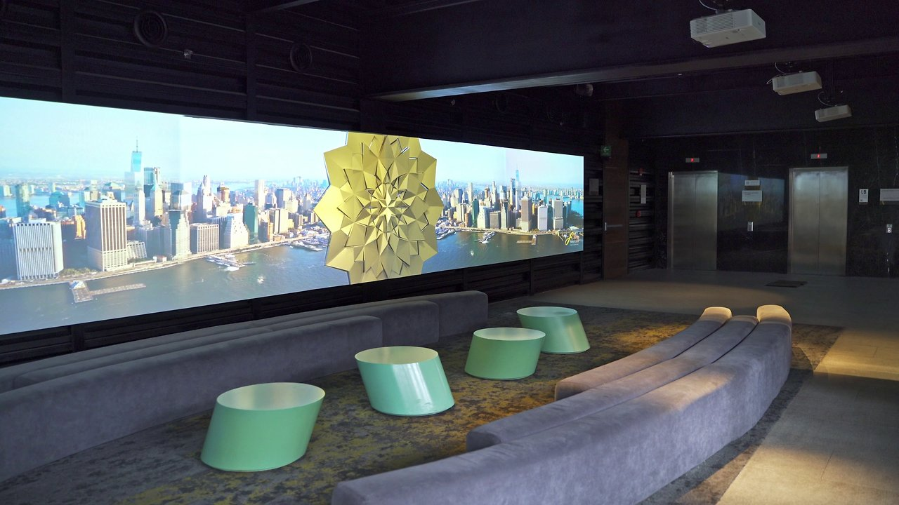
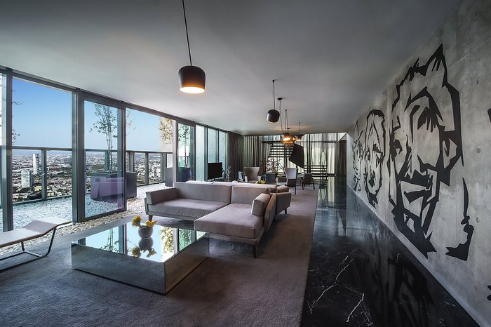
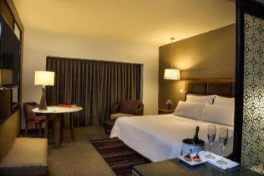
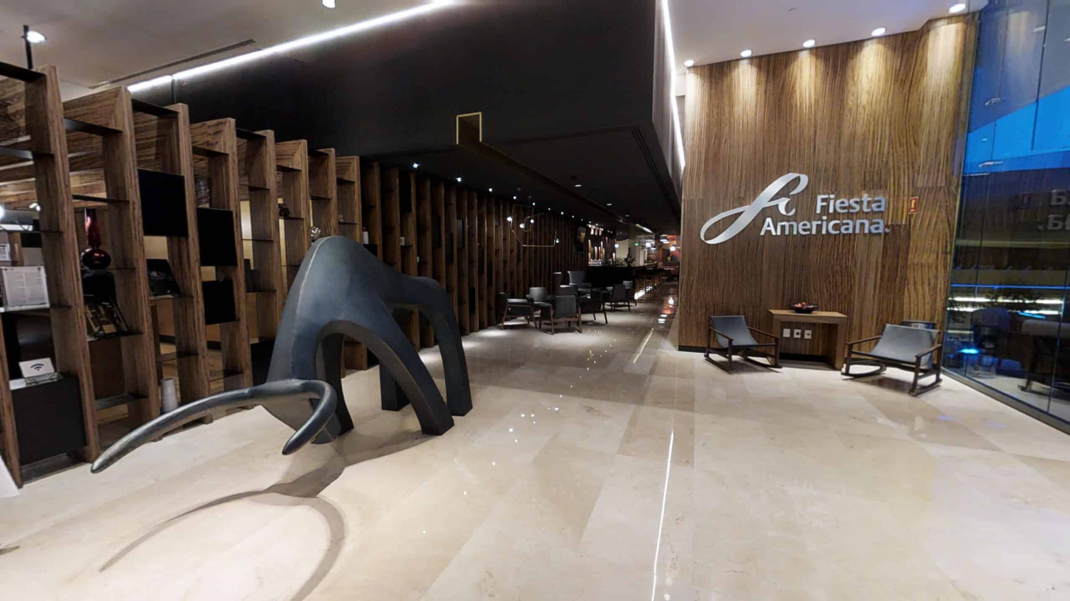
Fiesta Americana Viaducto Aeropuerto
Fiesta Americana Monterrey
Fiesta Americana Guadalajara
Fiesta Americana Toreo
¡BIENVENIDOS!

Slide 70

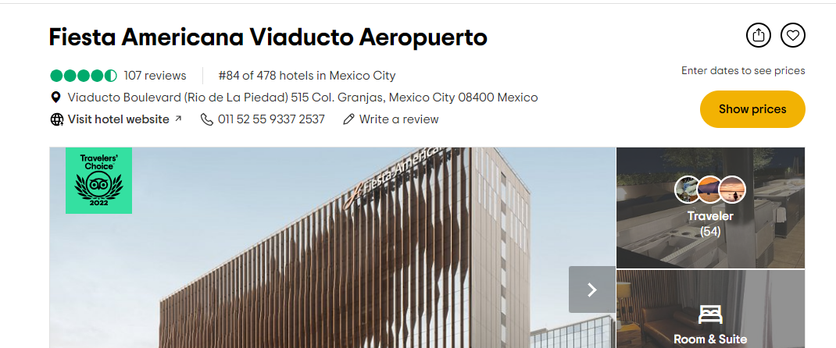
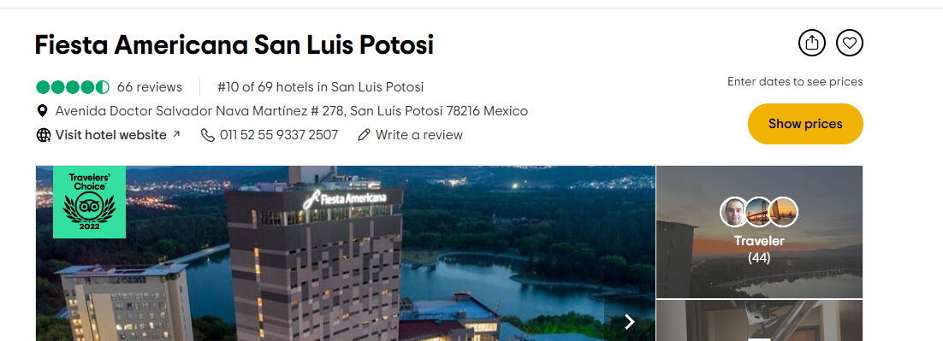
¡BIENVENIDOS!

Slide 71
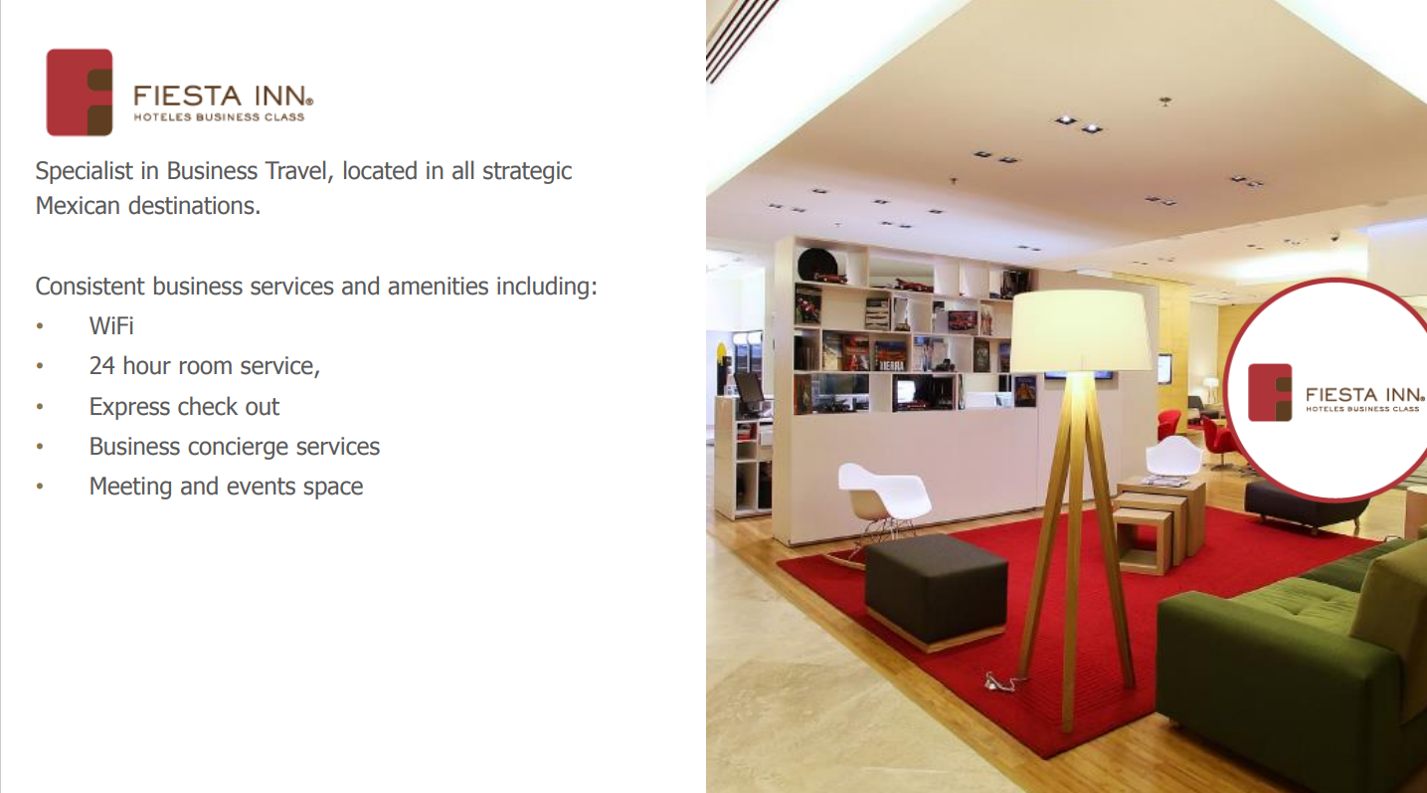

Slide 72
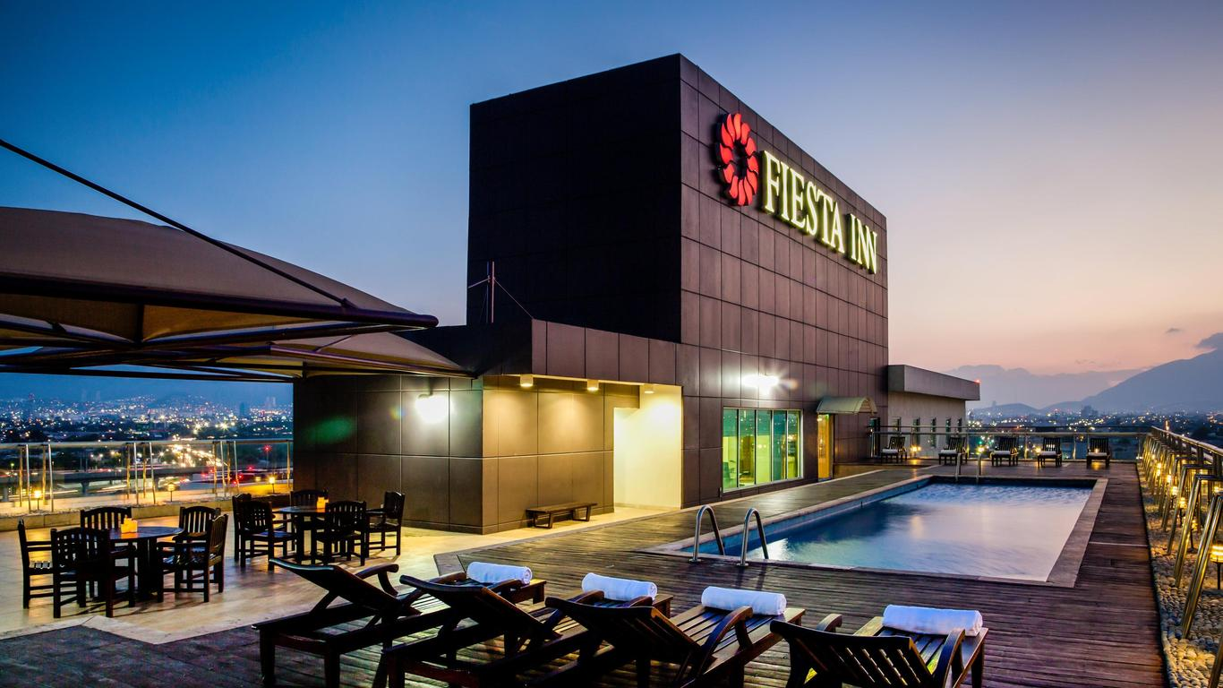
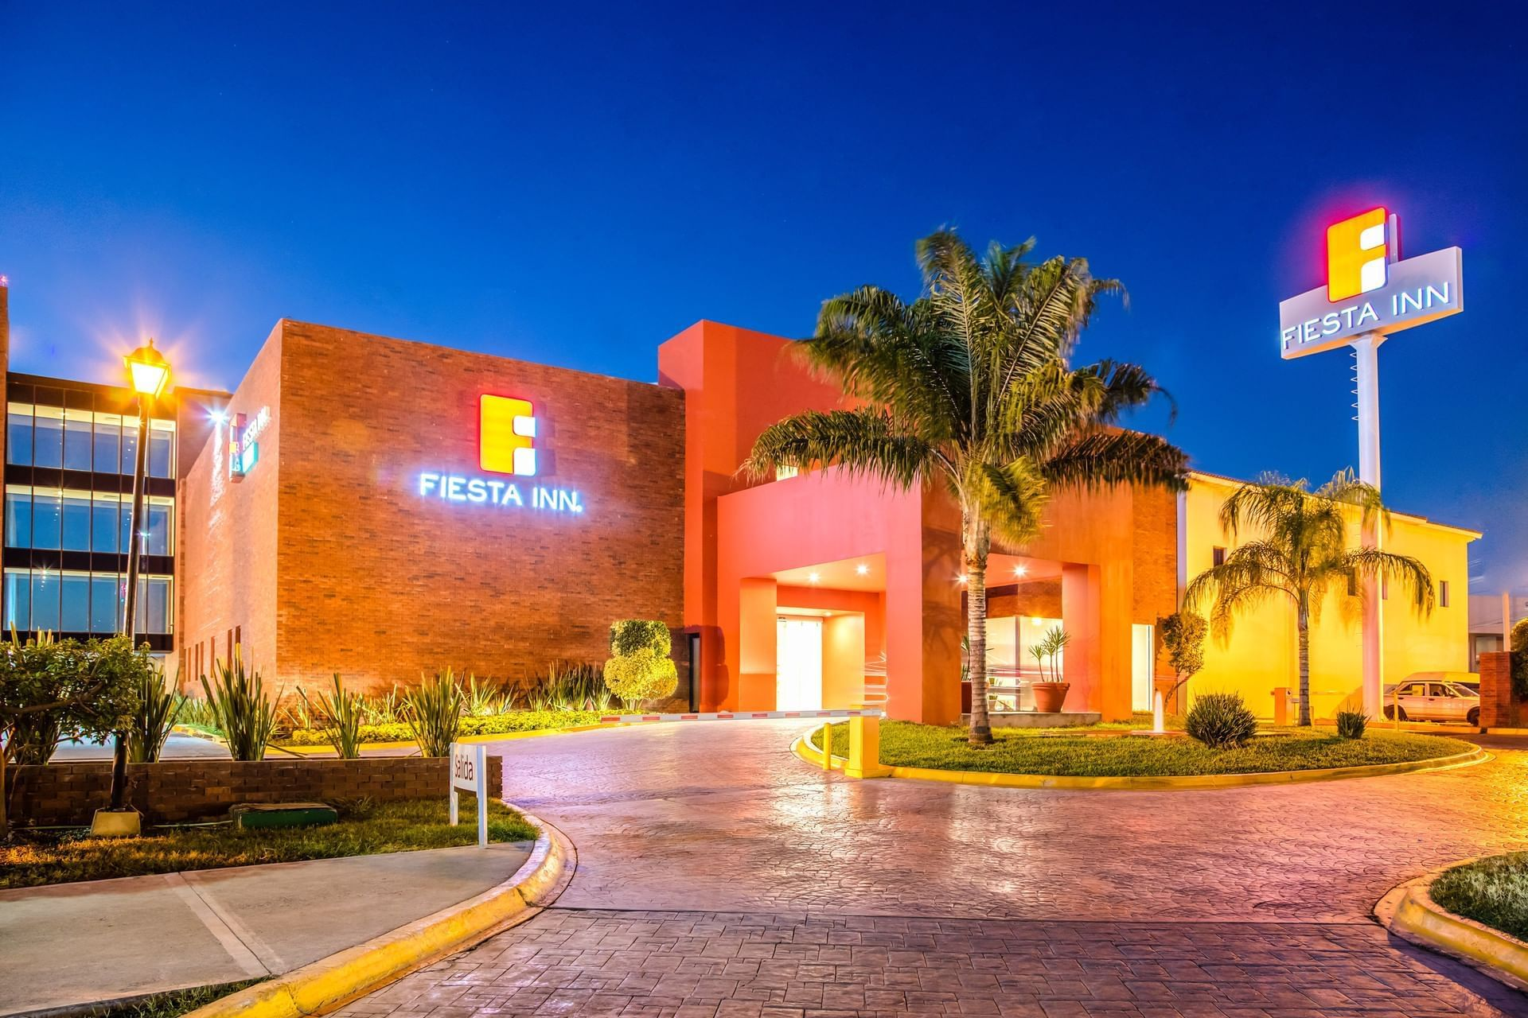

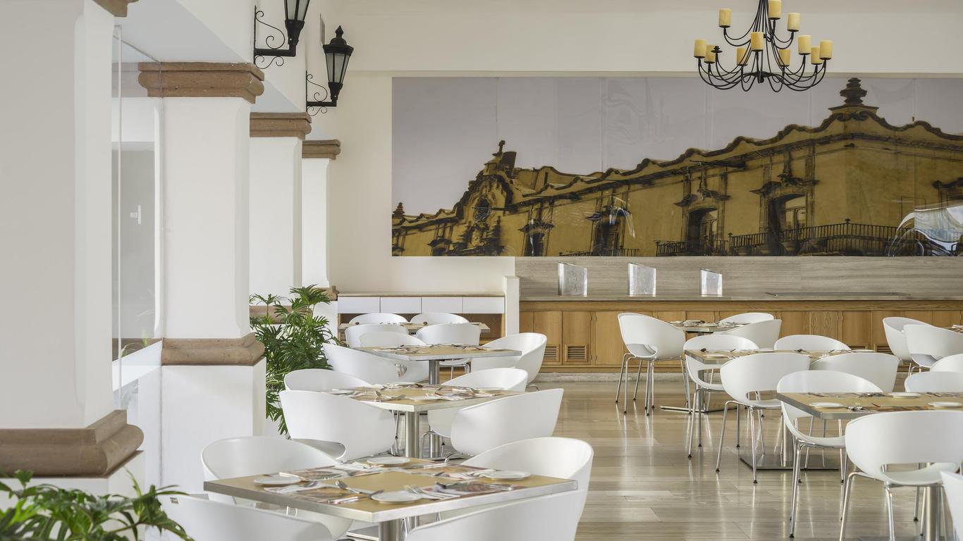


Slide 73


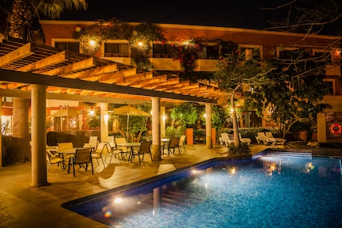
At Gamma, we merge the essence of your chosen destination with our signature hospitality, creating a space that you will love. Gamma offers you an inspiring space to rest and to enjoy each day during your stay, providing cozy rooms with unique design and warm interiors that immerse you in an environment full of comfort and tranquility.
¡BIENVENIDOS!

Slide 74

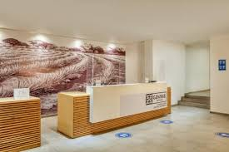
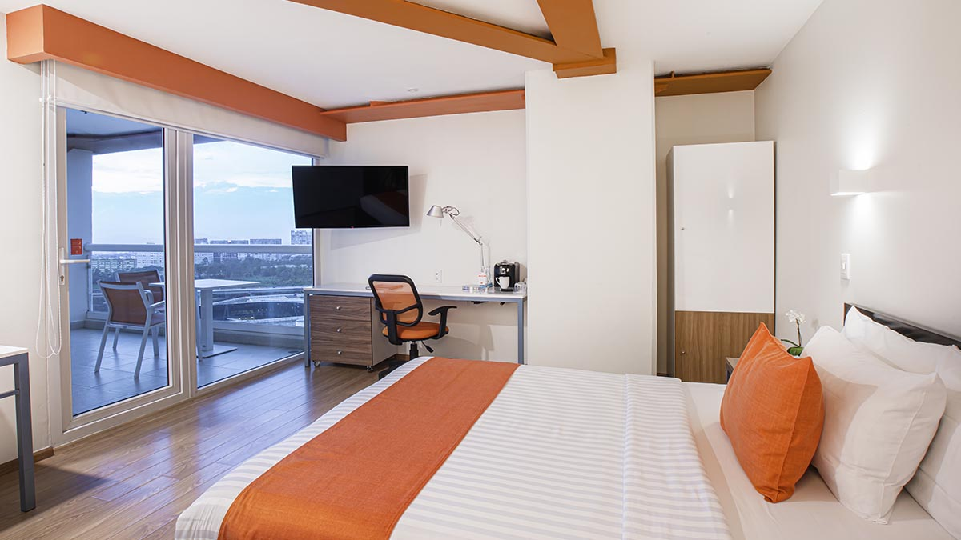
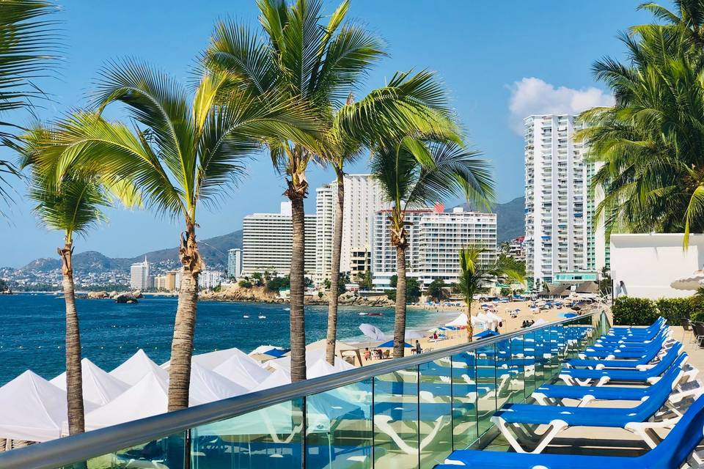


Slide 75

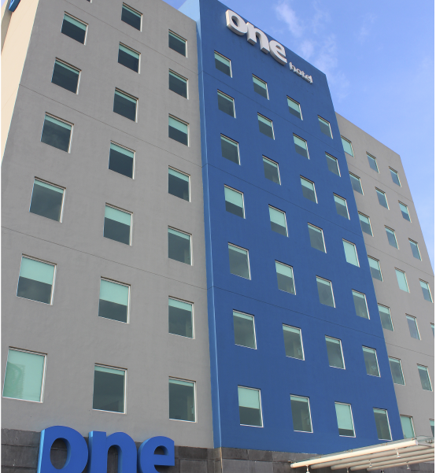

With an innovative self-service concept, we are a practical option for travelers who are looking for a hotel that offers relaxation, safety, and approachable technology, as well as friendly service, complimentary breakfast, and surprising details at a fair price. Because with one, you can travel for work, leisure, or a weekend getaway.

Slide 76
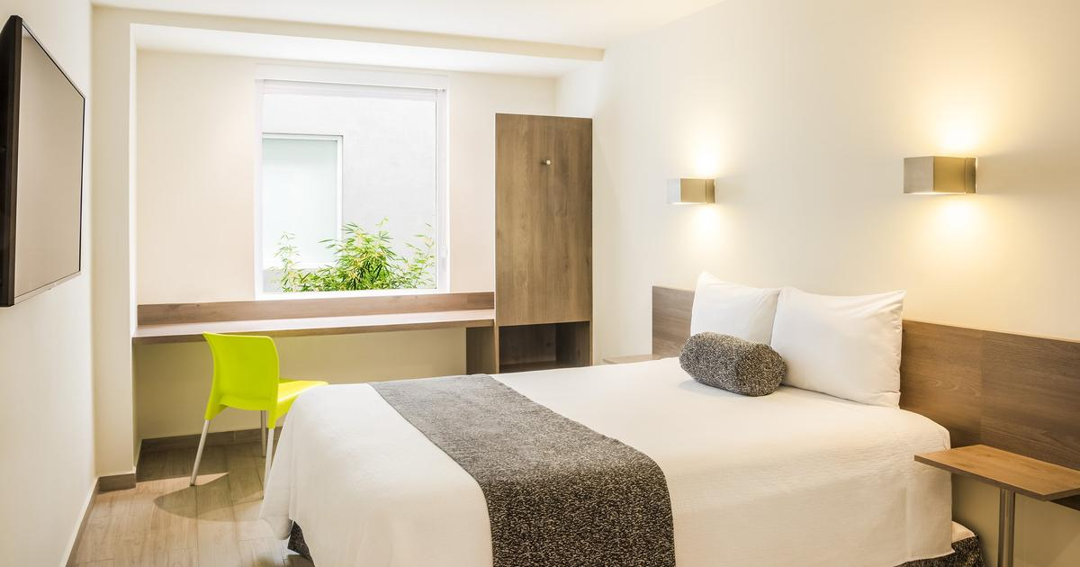
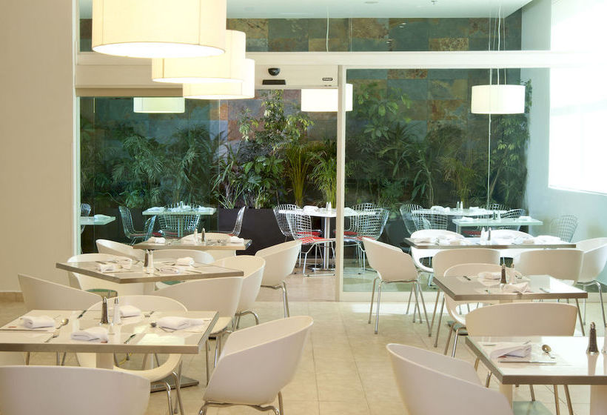
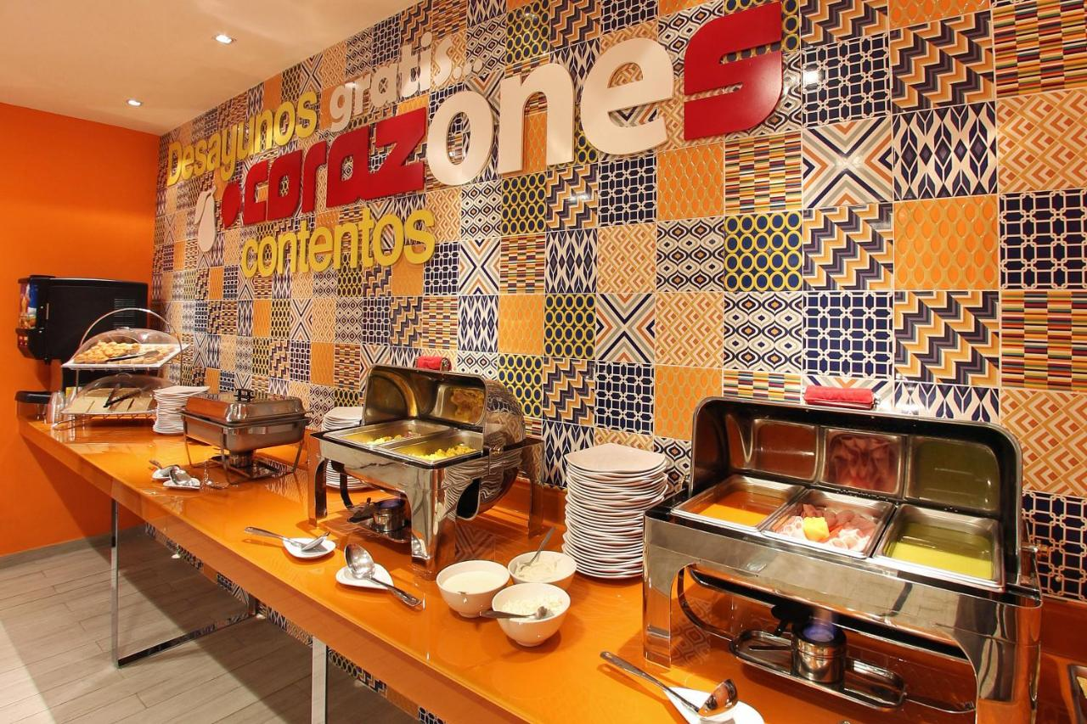
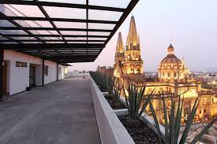

Slide 77
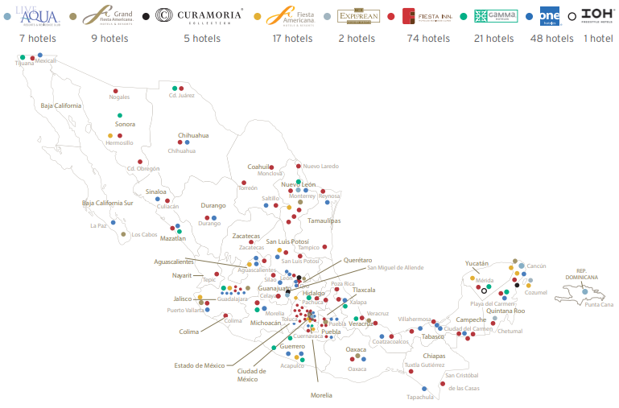
¡BIENVENIDOS!

Slide 78



Slide 79
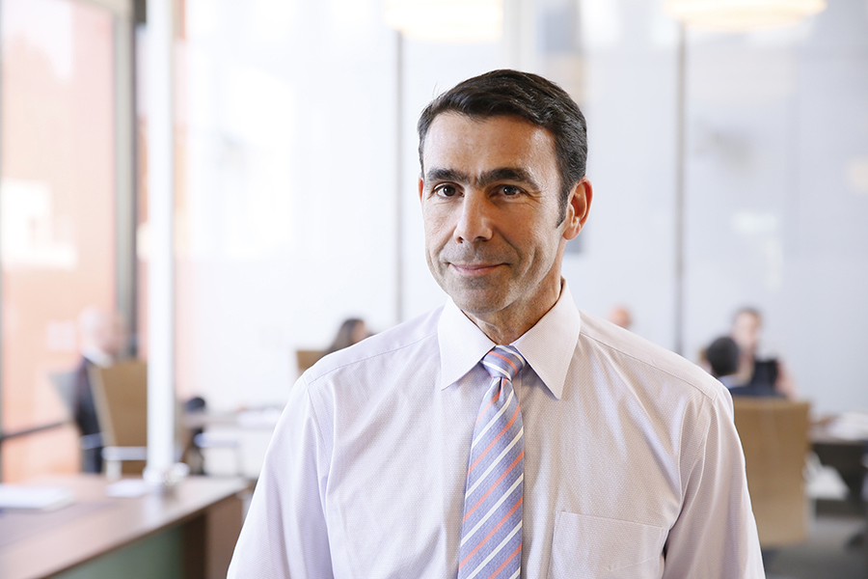
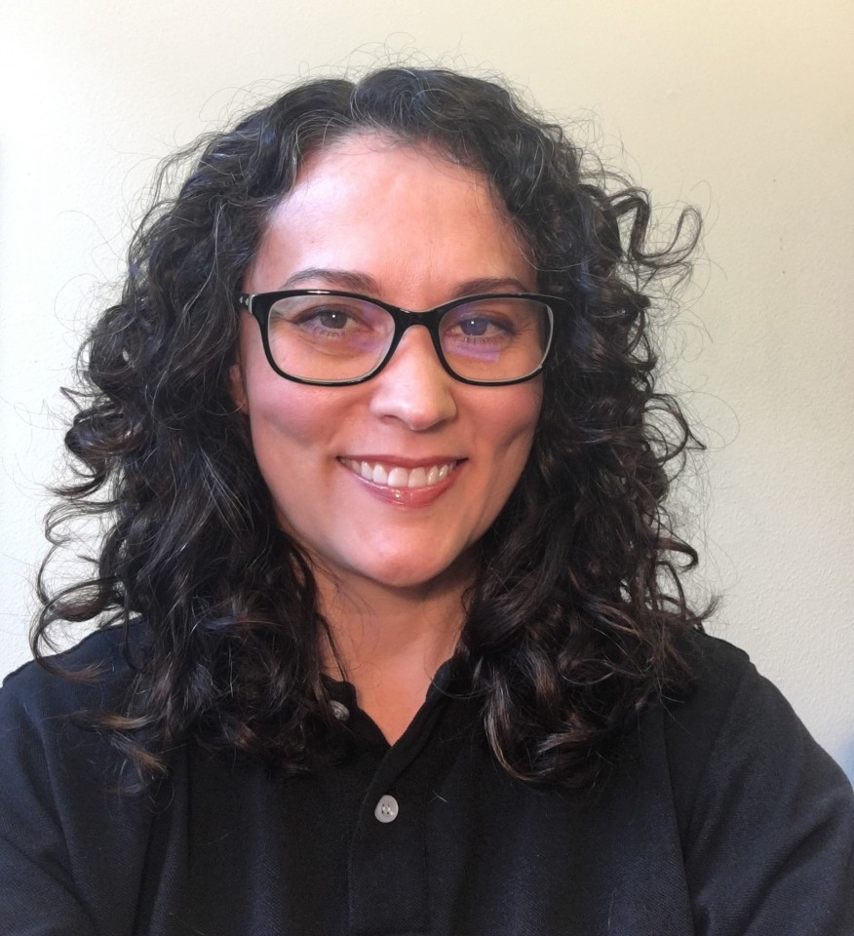
GBTA GLP – Flip the Script on your OBT RFP

Slide 80

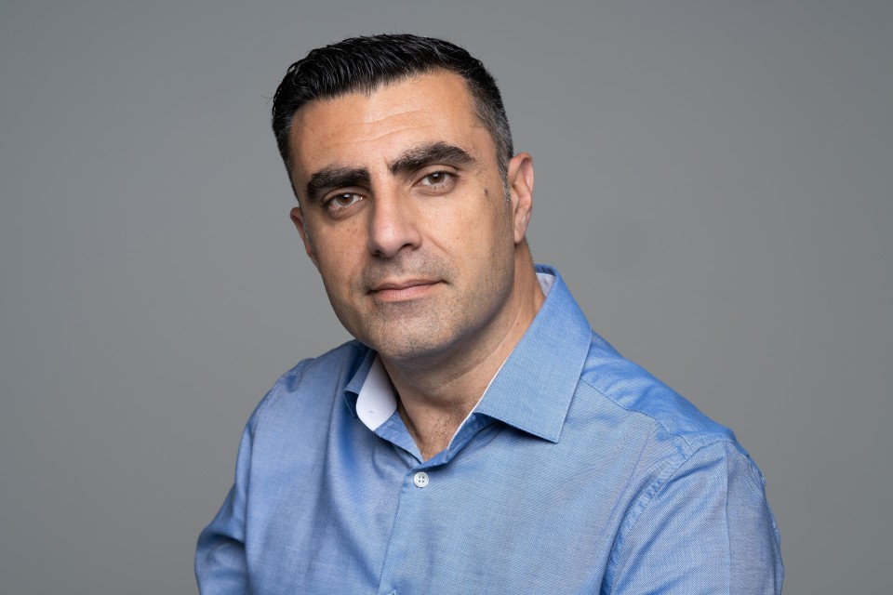

Slide 81
Final Announcements and Drawing

